Slide 1
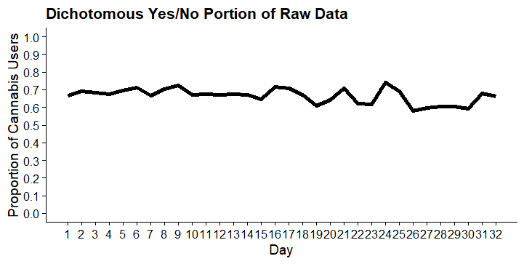
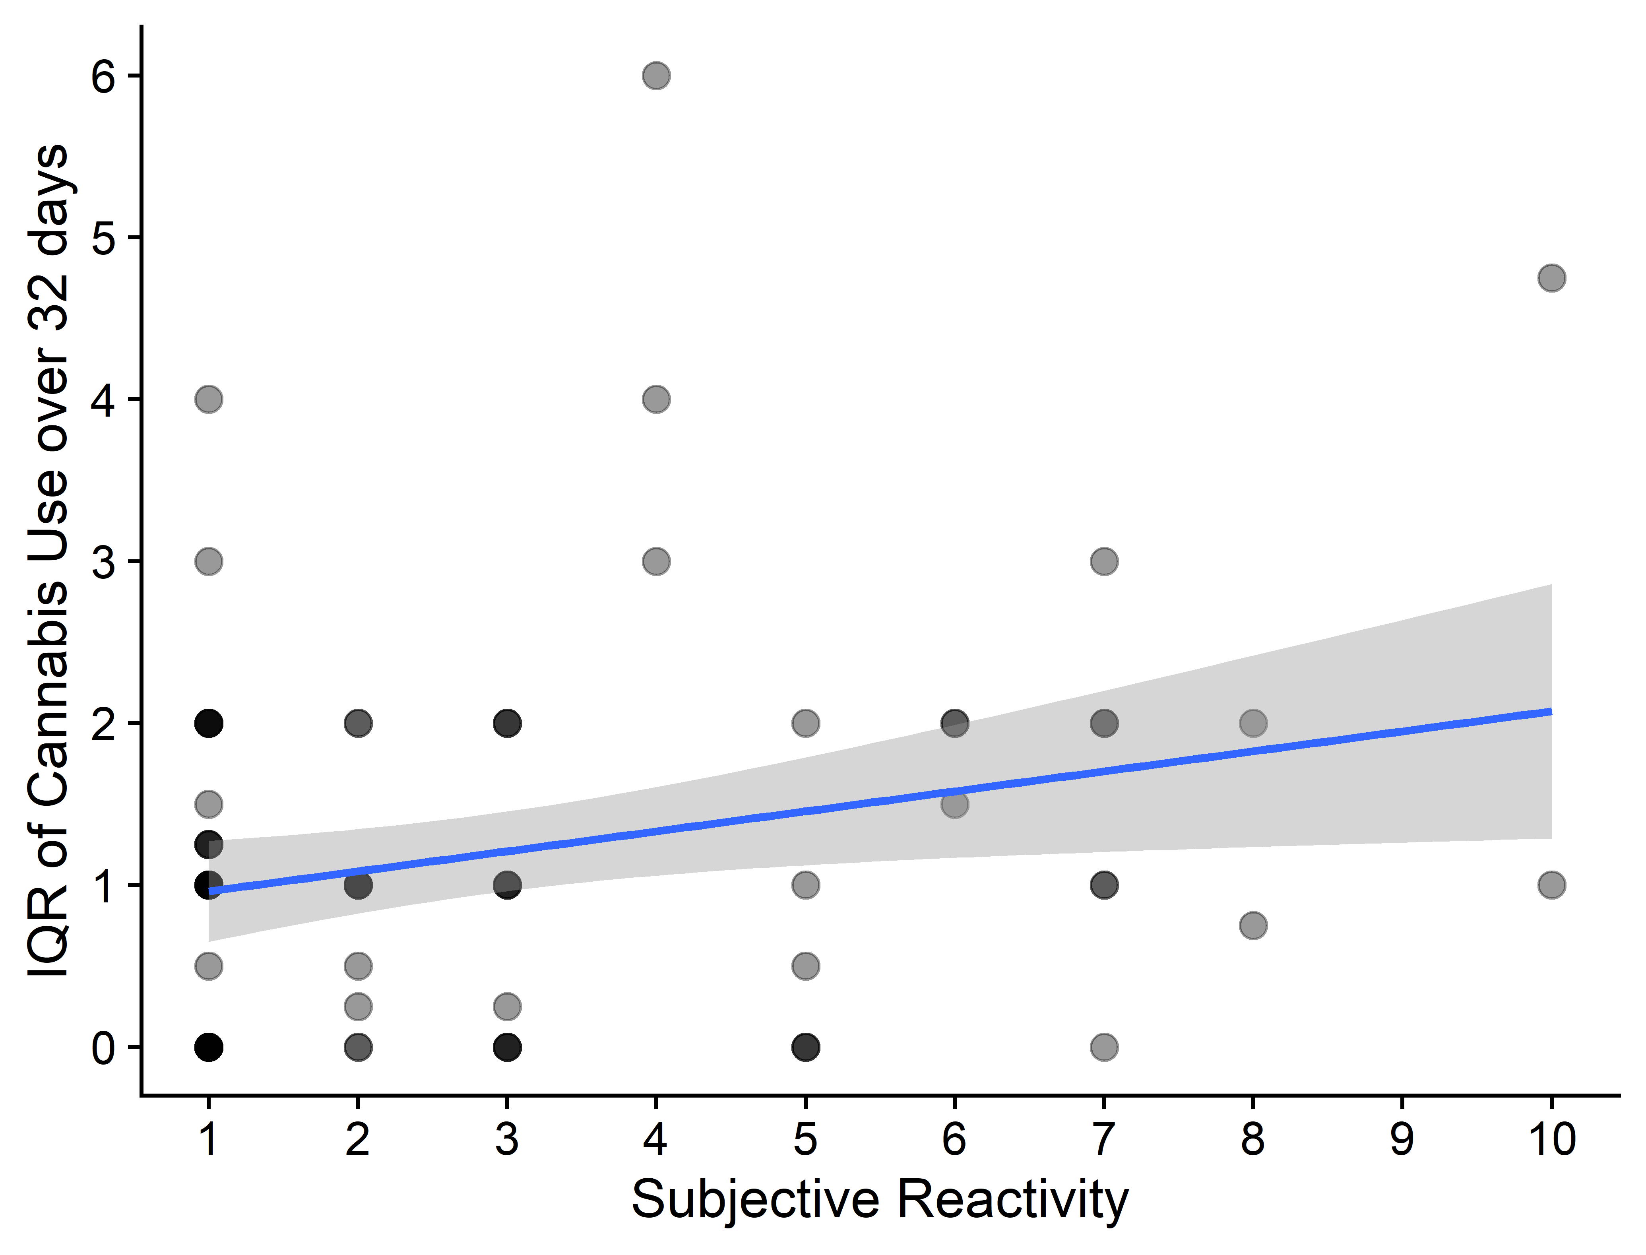
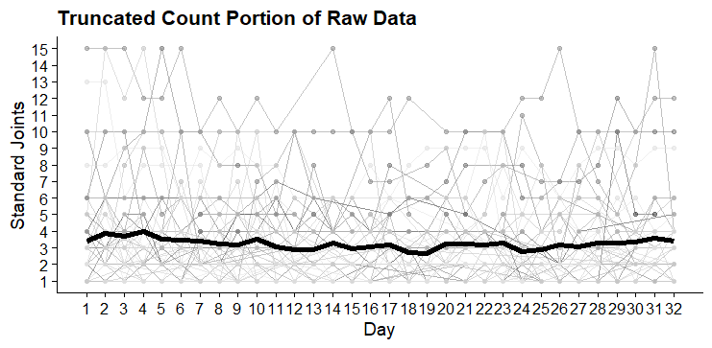
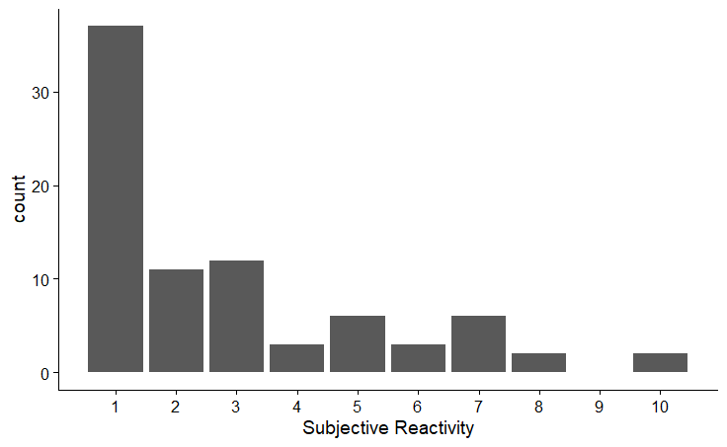
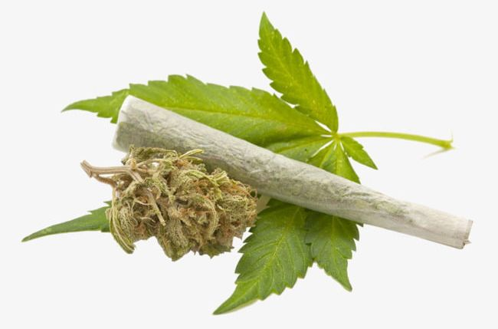
Cannabis Use Among Women:
Does Daily Assessment Reactivity Affect Usage Patterns?
Jason Y. Isaacs¹, Sean P. MacKinnon¹, Kayla M. Joyce², Sherry H. Stewart¹
¹Dalhousie University; ²University of Manitoba
Introduction
Methods
Results
Results (Continued)
Assessment reactivity refers to behavior change that occurs due to self-monitoring (Nelson & Hayes, 1981). In the addictions field, reactivity to daily self-monitoring has been identified as an intervention tool in clinical practice (Cohn et al., 2018), that may also pose a potential confound in daily diary research.
Objective reactivity (i.e., systematic mean changes over time) to daily self-monitoring has been investigated for alcohol and tobacco, and has generated mixed findings (e.g., Collins et al., 1998; Simpson, Kivlahan, Bush, and McFall, 2005).
Only one prior study has looked at daily diary reactivity for cannabis. Buu et al. (2020) found no evidence of reactivity; however they did not examine quantity – an outcome that warrants further exploration (Asbridge et al., 2014).
Subjective reactivity (i.e., participants’ self-rated perceptions of reactivity) is an alternative to looking for systematic changes in self-monitored behavior over time, however it has not been examined in the cannabis field, and researchers have not yet explored associations between subjective & objective reactivity.
STUDY OBJECTIVES
To investigate: (1) the impact of daily self-monitoring on the probability of daily cannabis use and cannabis use quantity over time; (2) participants’ perceptions of the impact of daily self-monitoring on their cannabis use; and (3) the relationship between objective and subjective reactivity in daily self-monitoring.
PARTICIPANTS AND PROCEDURE
Eighty-eight female cannabis users were recruited via advertisement for a study on cannabis use across the menstrual cycle (Joyce et al., under review).
Participants self-monitored cannabis use for 32 days. They recorded yes/no use and quantity twice per day. Only one measurement was used in the current study.
RELEVANT MEASURES
Daily Self-Monitoring. At 10:30am each day, participants were asked if they had used cannabis the previous day. When ‘yes’, they were asked for quantity used in ‘standard joints’ (.5 grams, five bong/pipe hits, or 10 puffs; Zeisser et al., 2012).
Subjective Perception of Reactivity. At debriefing, participants were asked to rate, on a 10-point scale, “To what extent did the monitoring impact your cannabis use behaviors”.
DATA ANALYSIS AND MODEL FIT
Analysis: Design was repeated measures nested within participants. Between- and within-subject changes were explored over 32 days. All models were run in R.
Model fit: Cannabis scores were zero inflated, and the random intercepts and random slope hurdle model was the best fit.
CANNABIS USE OVER 32 DAYS
No significant change in yes/no cannabis use (p=0.22).
No significant change in cannabis quantity (p=0.08).
SUBJECTIVE REACTIVITY
RELATIONSHIP BETWEEN OBT./SUB. REACTIVITY
Three-step hierarchical linear regression.
Time (step 1), subjective reactivity (step 2), the interaction (step 3).
Cannabis use remained non-significant at each step of the model for yes/no use (0.22 < p < 0.30).
Cannabis use also remained non-significant for quantity used (0.08 < p < 0.80).
There was a significant relationship between self-reported subjective reactivity and variability of cannabis use across 32 days of data collection (p=.02).
Demographic Variable | M (SD)/% | Valid N
Ethnicity |  | 87
Caucasian | 72.41%
Other | 27.59%
Education Level |  | 87
College/University Graduate or More | 68.97%
Some College/University or Less | 31.03%
Cannabis Use Risk |  | 87
Hazardous Use or More | 82.76%
Non-problematic Cannabis Use | 17.24%
Cannabis Using Days (30-Days Pre-Study) |  | 88
26-30 Days | 68.18%
≤ 25 Days | 31.82%
Age (in years) | 28.86 (6.11) | 87
Discussion and Conclusions
SUMMARY OF KEY FINDINGS
No significant changes in cannabis use over time.
Most participants reported at least some degree of subjective reactivity.
No evidence of subjective reactivity as a moderator of the relationship between time and cannabis use.
YES significant relationship between self-reported subjective reactivity and cannabis variability.
CONCLUSIONS
The lack of cannabis change resulting from reactivity (both when subjective reactivity was and was not included in the model) indicates that reactivity is unlikely to confound daily diary cannabis research but is also unlikely to be helpful as a standalone clinical intervention.
The relationship between subjective reactivity and cannabis variability suggests that increasing one’s awareness of cannabis behaviours may be an important first step in altering more consistent problematic usage.
LIMITATIONS AND FUTURE DIRECTIONS
Female sample; findings may not generalize.
Factors associated with behavioural change (e.g., motivation to change) were not measured.
Subjective reactivity did not look at directionality.

