Slide 1
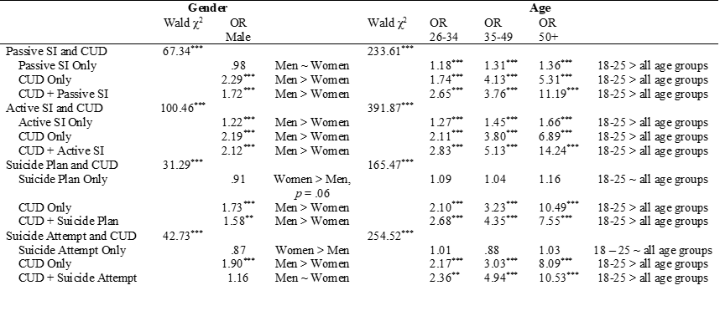
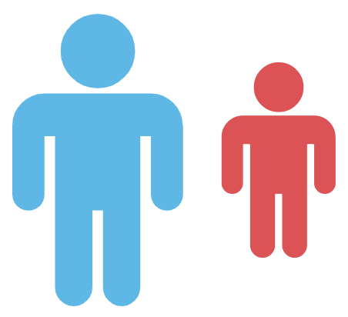
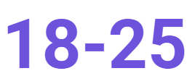
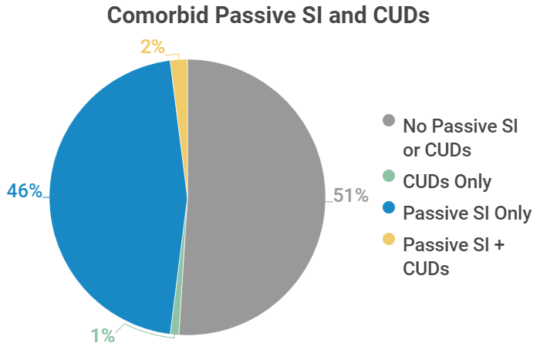
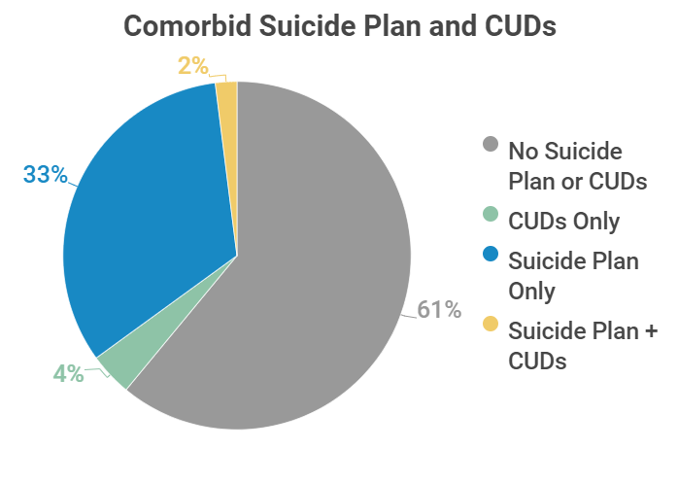
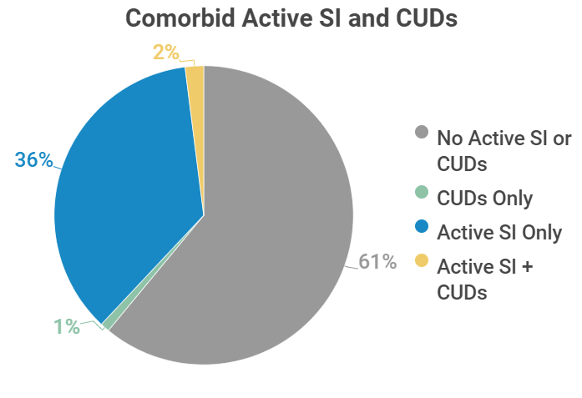
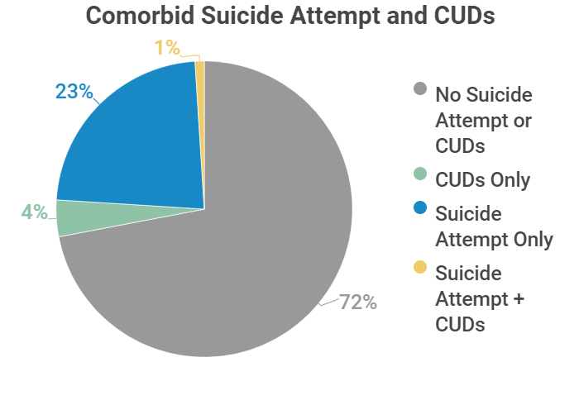
Men and emerging adults are disproportionately impacted by co-occurring cannabis use disorders and suicidality.
Non-Cognitive Predictors of Student Success: A Predictive Validity Comparison Between Domestic and International Students
Non-Cognitive Predictors of Student Success: A Predictive Validity Comparison Between Domestic and International Students
Non-Cognitive Predictors of Student Success: A Predictive Validity Comparison Between Domestic and International Students
Gender and Age Differences in Comorbid Cannabis Use Disorders and Suicidality in a National Sample
Lourah M. Kelly, Nicholas R. Livingston,
Tess K. Drazdowski, & Kristyn Zajac
INTRODUCTION
~40 million adults use marijuana annually, making marijuana one of the most commonly used substances in the US (SAMHSA, 2019).
Men and emerging adults (ages 18-25) report higher prevalence of cannabis use disorders (CUDs) vs. women and older adults (CBHSQ, 2015; Khan et al., 2013).
More frequent marijuana use is associated with greater likelihood of suicidal ideation (SI; Ilgen et al., 2009), and past year use in emerging adults predicts future suicide attempts (Pedersen, 2008).
Emerging adults and men have higher rates of suicidality (SAMHSA, 2019; Crosby et al., 2011; Krug et al., 2002).
Limited research has tested gender and age differences in comorbid CUDs and suicidality.
Current Study: Examine gender and age differences in CUDs only, suicidality only, and comorbid CUDs + suicidality in a national sample of adults.
H₁:Men and emerging adults would be over-represented in CUDs + suicidality and CUDs only groups.
METHODS
Data were from four consecutive years (2015-2018) of the National Survey of Drug Use and Heath
Multinomial logistic regressions tested gender and age differences in adults with DSM-IV:
Cannabis abuse or dependence (CUDs) only
Suicidality only
Comorbid CUDs + suicidality
Vs. neither CUDs or suicidality
Four separate regressions for each suicidality type
1) Passive SI
2) Active SI
3) Suicide planning
4) Suicide attempts
Gender: male or female
Age groups: 18–25, 26–34, 35–49, and 50+
Covariates: survey year, race/ethnicity, sexual orientation, education, household income, past year major depressive episode, past year DSM-IV alcohol abuse or dependence, and past year DSM-IV illicit drug abuse or dependence other than CUDs
RESULTS
Gender:
Men > CUDs only
Men > Active SI
Women > Suicide attempts
Men > CUDs + passive SI, active SI, and suicide planning, but not attempts relative to women
Age:
Emerging adults > CUDs only
Emerging adults > Passive SI, active SI
Emerging adults > CUDs + all four forms of suicidality
DISCUSSION
Men and emerging adults consistently reported the highest likelihood of comorbid CUDs + suicidality
Clinical implications: Need to develop and invest in programs for emerging adults with CUDs, suicidality, and their comorbidity given the striking risk profile vs. other age groups
Future research: (1) Direction of the relationship between CUDs and increasing severity of suicidality and
(2) Program development and evaluation, as well as gathering more information on risk and protective factors, for these populations
♂
♀
References
Center for Behavioral Health Statistics and Quality. (2015). 2014 National Survey on Drug Use and Health: Detailed tables. Substance Abuse and Mental Health Services Administration, Rockville, MD.
Crosby, A., Gfroerer, J., Han, B., Ortega, L., & Parks, S. E. (2011). Suicidal thoughts and behaviors among adults aged ≥ 18 Years—United States, 2008 –2009. Washington, DC: US Department of Health and Human Services, Centers for Disease Control and Prevention.
Ilgen, M. A., Walton, M. A., Cunningham, R. M., Barry, K. L., Chermack, S. T., De Chavez, P., & Blow, F. C. (2009). Recent suicidal ideation among patients in an inner city emergency department. Suicide and Life-Threatening Behavior, 39, 508-517.
Khan, S. S., Secades-Villa, R., Okuda, M., Wang, S., Pérez-Fuentes, G., Kerridge, B. T., & Blanco, C. (2013). Gender differences in cannabis use disorders: Results from the National Epidemiologic Survey of Alcohol and Related Conditions. Drug and Alcohol Dependence, 130, 101-108.
Krug, E. G., Mercy, J. A., Dahlberg, L. L., & Zwi, A. B. (2002). The world report on violence and health. The Lancet, 360, 1083-1088.
Pedersen, W. (2008). Does cannabis use lead to depression and suicidal behaviours? A population‐based longitudinal study. Acta Psychiatrica Scandinavica, 118, 395-403.
Substance Abuse and Mental Health Services Administration (2019). Key substance use and mental health indicators in the United States: Results from the 2018 National Survey on Drug Use and Health (HHS Publication No. SMA 18-5068, NSDUH Series H-53). Rockville, MD.
This research was supported by T32AA007290 (National Institute on Alcohol Abuse and Alcoholism; NIAAA) that covered the time of Dr. Kelly and K23DA048161 (National Institute on Drug Abuse, NIDA) that covered the time of Dr. Drazdowski.
Correspondence: lkelly@uchc.edu

