Slide 1
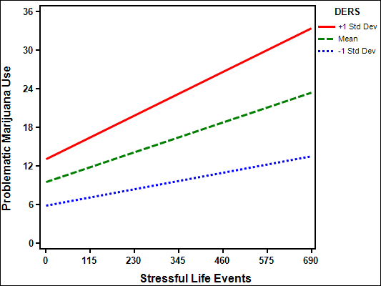
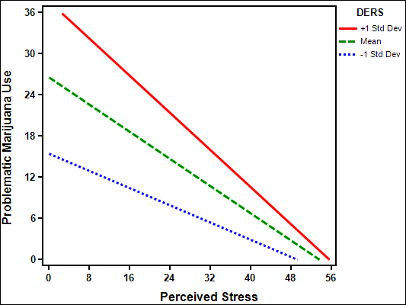
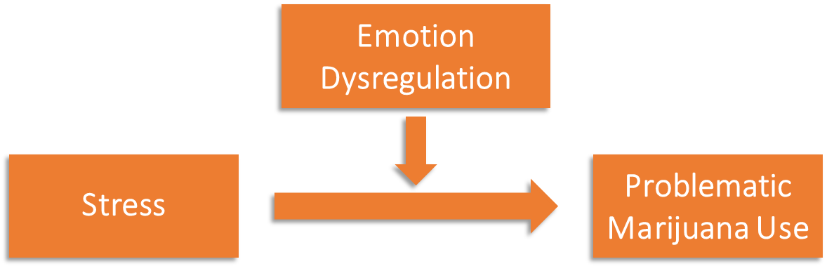
Emotion Dysregulation Moderates the Association Between Stress and Problematic Marijuana Use Jessica M. Cavalli¹, M.S. & Anita Cservenka¹, Ph.D. ¹School of Psychological Science, Oregon State University
Introduction
Results
Stressful life events are risk factors for greater coping-motivated marijuana use, cannabis use disorder, and cannabis dependence (Hyman & Sinha, 2009; Myers et al., 2014; Blanco et al., 2014; van der Pol et al., 2013).
Perceived stress is associated with problematic marijuana use (Ketcherside & Filbey, 2015; Liao et al., 2019; Spradlin & Cuttler, 2019).
Emotion dysregulation is a risk factor for problematic marijuana use (Dvorak & Day, 2014; Kentopp et al., 2019; Simons & Carey, 2002; Vilhena-Churchill & Goldstein, 2014).
Individual differences in emotion dysregulation have been found to moderate associations between stress and other substance use outcomes (e.g. alcohol use; Paulus et al., 2019).
The current study investigated past year stressful life events and past month perceived stress to make direct comparisons in the moderating role of emotion dysregulation on the association between stress and past month problematic marijuana use.
Emotion Dysregulation Moderates the Association between Stressful Life Events and Problematic Marijuana Use
Emotion Dysregulation Moderates the Association between Perceived Stress and Problematic Marijuana Use
Methods
Participants:
852 adults reporting any lifetime marijuana use completed an online anonymous survey
Participants were excluded if they were not U.S. citizens, were not age of majority, or were not fluent in English
5 data cleaning rules were used to exclude random responders
Age: M = 26.88(6.71), Range: 18-67
63% Male
67% Not Hispanic/Latinx
66% White
62% Middle class ($50K - $100K)
36% Some college
Measures:
Marijuana Problem Scale (MPS; Stephens et al., 2000)
Difficulties in Emotion Regulation Scale (DERS; Gratz & Roemer, 2004)
Holmes-Rahe Life Stress Inventory (H-RLSI; Holmes & Rahe, 1967)
Perceived Stress Scale (PSS; Cohen et al., 1983)
Statistical Analysis:
Pearson’s correlations were used to examine whether emotion dysregulation, stressful life events, and perceived stress were associated with problematic marijuana use.
Hierarchical linear regression was used to examine the moderating role of emotion dysregulation on the associations between stress and problematic marijuana use. We included the following covariates in our models: age, biological sex, ethnicity, race, income, education, and past 30-day marijuana use.
Coefficients | B | p
Emotion Dysregulation | .32 | <.001
Stressful Life Events | .21 | <.001
Interaction | .07 | .003
Note. R² = .59
Coefficients | B | p
Emotion Dysregulation | .44 | <.001
Perceived Stress | -.18 | <.001
Interaction | -.06 | .04
Note. R² = .56
Conclusions
Emotion dysregulation, stressful life events, and perceived stress were positively associated with problematic marijuana use.
With emotion dysregulation in the model, more stressful life events and less perceived stress predicted more problematic marijuana use.
Greater emotion dysregulation strengthened these relationships.
Individuals with difficulties regulating emotions and who experience greater stressful life events may be among those at highest risk for developing problematic marijuana use.
These findings highlight the importance of examining both emotion dysregulation and stress and comparing different aspects of stress in relation to marijuana-use outcomes.
Pearson’s Correlations Between Primary Variables
 | 1 | 2 | 3 | 4
1. Problematic Marijuana Use | -
2. Stressful Life Events | .32 | -
3. Perceived Stress | .13 | .13 | -
4. Emotion Dysregulation | .53 | .17 | .53 | -
Note. All p’s < .001
Funded by: Start-up research funds to Dr. Cservenka provided by Oregon State University
Contact information: cavallje@oregonstate.edu

