Slide 1
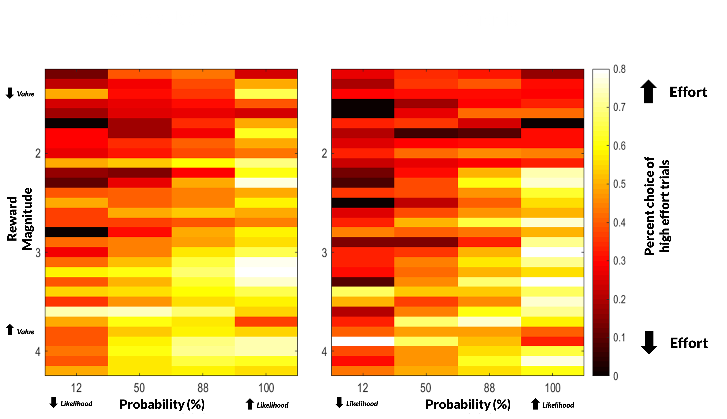
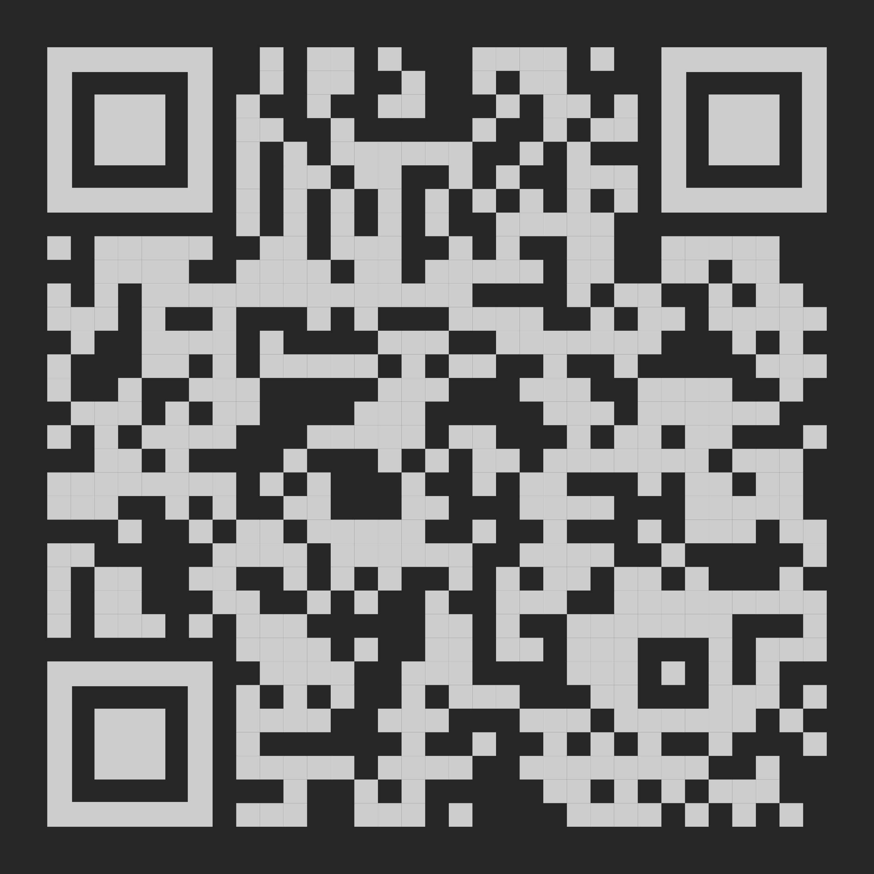
College students who use cannabis are more likely to expend effort for rewards.
Aberrant Effort-related Decision Making among Cannabis Using College Students
Non-Cognitive Predictors of Student Success: A Predictive Validity Comparison Between Domestic and International Students
RESULTS: IN THE “WEEDS”
On average, participants selected the hard trials 46% of the time (SD = 19%).
Participants successfully completed the hard trials 74% of the time (SD 29%), while they completed the easy trials 97% of the time (SD = 6%).
Cannabis users (M=41.40, SD=3.55) completed significantly fewer trials compared to nonusers (M=43.64, SD=3.74).
Further, Nonusers (M=26.82, SD=10.01) selected easy trials significantly more often compared to cannabis users (M=21.40, SD=8.34), and nonusers (M=99%, SD=2%) also successfully completed easy trials more often compared to cannabis users (M=95%, SD=7%).
However, cannabis users and nonusers did not differ in the number of hard trials selected (Cannabis users M=16.82, SD=5.67; Nonusers M=16.82, SD=7.68) or the percentage of successfully completed hard trials out of the total number of hard trials (Cannabis users M=72%, SD=27%; Nonusers M=76%, SD =32%).
There was no magnitude X probability X expected value interaction.
Cannabis users were more likely to select the high effort choice across all levels of risk and value.
PRESENTER:
Samuel Acuff
BACKGROUND: Cannabis is the most commonly used illicit drug in the US and might be associated with aberrant effort-based decision making through dopamine pathways. The dominate hypothesis regarding this relation is the amotivational syndrome hypothesis, in which chronic cannabis use results in decreased effort. Understanding this relationship is important to understanding the risk profile of cannabis use, in addition to potential therapeutics for addressing cannabis use disorder.
METHODS
Cannabis using (n = 25) and non-cannabis using (n = 22) college students completed the EEfRT task
In the EEfRT task, participants choose between a ‘hard’ task that requires pressing a button 100 times with the nondominant little finger for a large sum of money (high effort/high reward) or an ‘easy’ task that requires pressing a button 30 times with the dominant index finger for a smaller sum of money (low effort/low reward).
Independent sample t-tests were used to compare results between cannabis and non-cannabis using groups.
Generalized estimating equation models were used to see if cannabis use days, and cannabis use disorder predicted the likelihood of making a high-effort choice.
RESULTS
Nonusers selected easy trials significantly more often compared to cannabis users and also successfully completed easy trials more often compared to cannabis users.
Past month cannabis days and cannabis use disorder symptoms predicted the likelihood of selecting a hard trial, such that greater levels of both cannabis use days and symptoms were associated with an increased likelihood after controlling for reward value, probability, and expected value
IMPLICATIONS
The results do not support the amotivational hypothesis, but rather suggest that college students who use cannabis are less sensitive to changes in risk and reward magnitude during effort-related decision making, suggesting aberrant reward processing.
The percentage of high effort (relatively to low effort) choices as a function of reward value and magnitude, split by cannabis users and controls. Dark/red colors indicate a low likelihood of selecting the high effort choice at that specific reward magnitude and probability, while the lighter/yellow color indicates a greater likelihood of selecting the high effort choice at that specific reward magnitude and probability.
Samuel F. Acuff, Nicholas W. Simon, James G. Murphy
Take a picture to download the poster
Notes:
Notes:
In Powerpoint, click View > Guides
Keep text within gutter guides.
Author list: Don’t split names onto two lines (e.g., “Jimmy [break] Smith”). If that happens, use a new line, unless you need the space. Bold the first names of anybody who’s presenting in person.
Intro/methods/result: Do not drop below font size 28, but if you have extra space, jack up the font size until the space is full.
Do not use color in the sidebars except in graphs/figures. It’ll pull attention from the center and slow interpretation for passersby.

