Slide 1
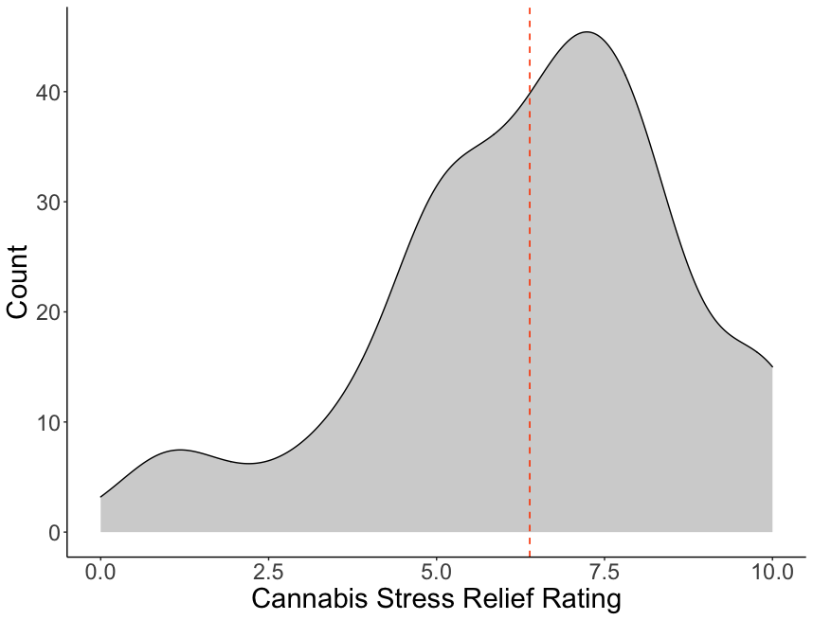
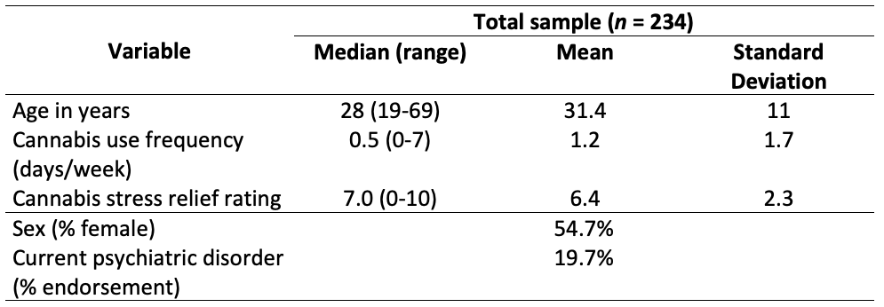
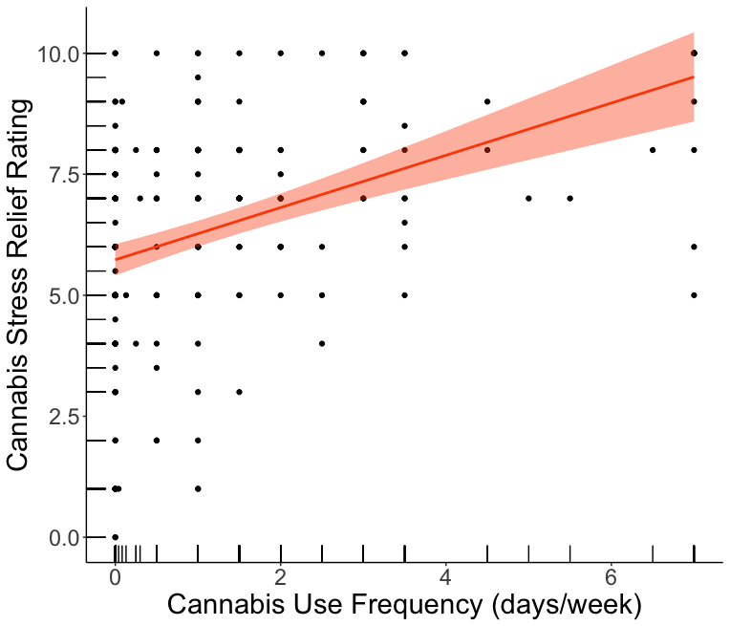
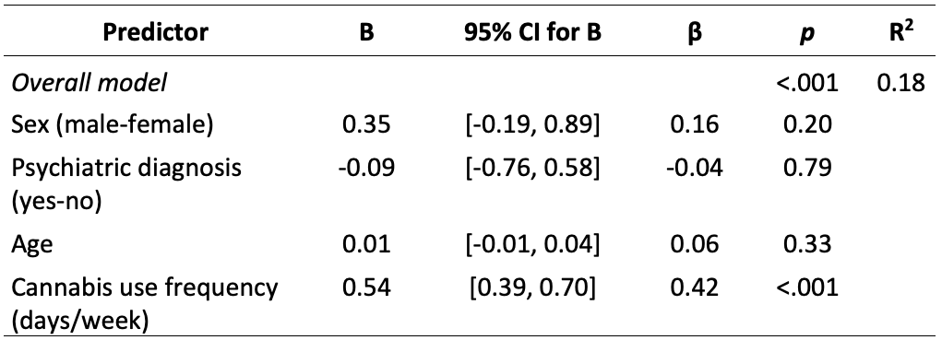
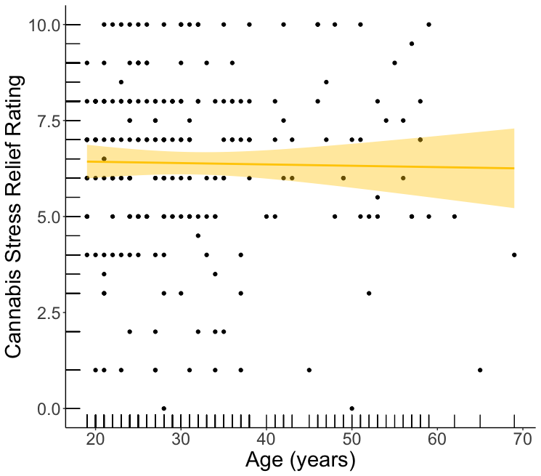
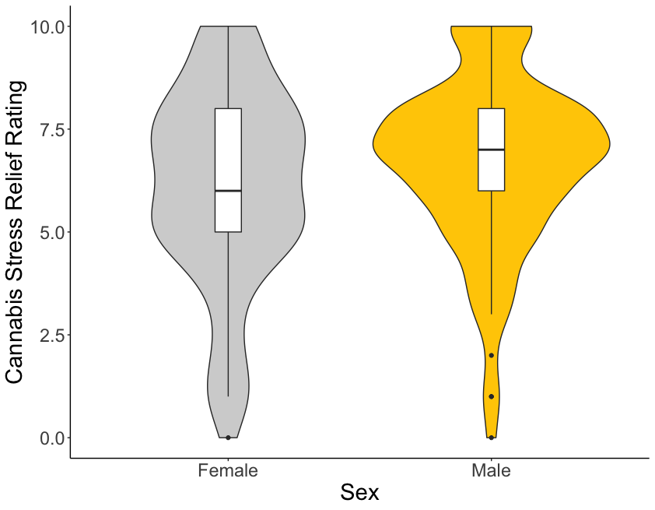
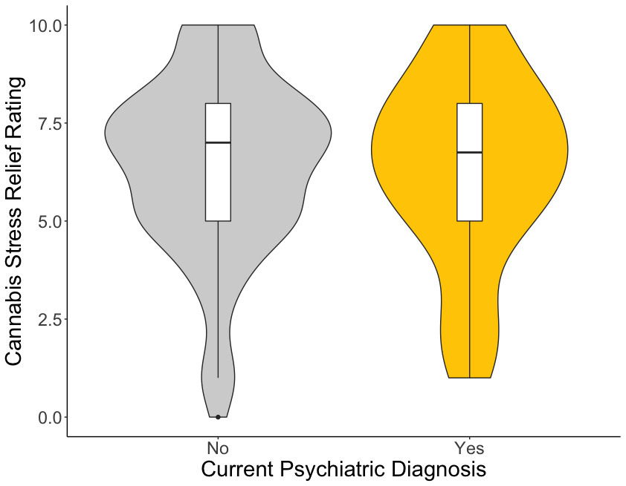
Evaluating expectancies: Do community-recruited adults believe that cannabis is an effective stress reliever?
Toni C. Spinella, MSc¹ & Sean P. Barrett, PhD^{1,2}
¹Dalhousie University, Department of Psychology and Neuroscience
²Dalhousie University, Department of Psychiatry
BACKGROUND
RESULTS
DISCUSSION
Increased clinical interest in using cannabis/specific cannabinoids (e.g., THC, CBD) as therapeutic agents for various stress-related psychiatric disorders (e.g., PTSD, anxiety) (Abizaid et al., 2019; Borodovsky & Budney, 2018; Khan et al., 2020)
Medical cannabis users perceive cannabis as moderately to very helpful for stress, anxiety, depression, and PTSD (Bonn-Miller et al., 2014)
Drug effects in humans are comprised of a pharmacological effect and a placebo response (Kirsch, 1985)
Apriori beliefs about a drug (i.e., stimulus expectancies) can influence the actual effects experienced by individuals
Stimulus expectancies activate response expectancies (i.e., predictions of one’s own response to a drug) and can lead to biased clinical outcomes (Fulton & Barrett, 2008; Kirsch, 2018)
However, these apriori beliefs are rarely evaluated in clinical research
Given the interest in using cannabis for various stress-related conditions, it is important to also evaluate beliefs regarding its’ efficacy for such conditions
SUMMARY OF FINDINGS
Sample of community-recruited adults believe that cannabis is at least somewhat effective at relieving stress (Mean=6.4, Median=7)
Only frequency of current cannabis use was associated with the strength of this belief ($↑$frequency of use = $↑$ belief rating)
CONCLUSIONS AND IMPLICATIONS
Findings are in line with prior research showing associations between heavier cannabis use and higher relaxation/tension reduction expectancy ratings (Hayaki et al., 2010)
Extends prior research by evaluating other predictors of cannabis-related beliefs (e.g., age, psychiatric disorder)
Given that stimulus expectancies have been shown to influence substance-related responses, these findings bolster the case for evaluating and controlling for these expectancies in clinical work with cannabis for stress-related conditions
Findings also suggest that clinical cannabis research that utilize samples of heavy/frequent cannabis users may be subject to bias due to higher positive expectancies
LIMITATIONS & FUTURE DIRECTIONS
Cannot infer causation due to cross-sectional nature of data
Limited assessment of cannabis use frequency and severity
Evaluate the directionality of the relationship between positive cannabis expectancies and cannabis use frequency/severity via longitudinal designs
Explore expectancies related to different cannabinoids (CBD, THC) and cannabis strains (Indica, Sativa)
Table 1. Participant characteristics
Mean
ANALYTIC STRATEGY
Multiple regression analysis (SPSS v25)
Predictors: sex, age, current psychiatric diagnosis, frequency of current cannabis use
Outcome: cannabis stress relief rating
OBJECTIVES
1
2
Evaluate the extent to which individuals believe that cannabis relieves stress
Examine whether individual characteristics (age, sex, presence of psychiatric disorders, cannabis use frequency) are related to these beliefs
Table 2. Multiple regression model coefficients
REFERENCES
Abizaid, A., Merali, Z., & Anisman, H. (2019). Cannabis: A potential efficacious intervention for PTSD or simply snake oil? Journal of Psychiatry & Neuroscience : JPN, 44(2), 75–78. https://doi.org/10.1503/jpn.190021
Bonn-Miller, M. O., Boden, M. T., Bucossi, M. M., & Babson, K. A. (2014). Self-reported cannabis use characteristics, patterns and helpfulness among medical cannabis users. The American Journal of Drug and Alcohol Abuse, 40(1), 23–30. https://doi.org/10.3109/00952990.2013.821477
Borodovsky, J. T., & Budney, A. J. (2018). Cannabis regulatory science: Risk-benefit considerations for mental disorders. International Review of Psychiatry (Abingdon, England), 30(3), 183–202. https://doi.org/10.1080/09540261.2018.1454406
Fulton, H. G., & Barrett, S. P. (2008). A Demonstration of Intravenous Nicotine Self-Administration in Humans? Neuropsychopharmacology, 33(8), 2042–2043. https://doi.org/10.1038/sj.npp.1301545
Hayaki, J., Hagerty, C. E., Herman, D. S., de Dios, M. A., Anderson, B. J., & Stein, M. D. (2010). Expectancies and marijuana use frequency and severity among young females. Addictive Behaviors, 35(11), 995–1000. https://doi.org/10.1016/j.addbeh.2010.06.017
Khan, R., Naveed, S., Mian, N., Fida, A., Raafey, M. A., & Aedma, K. K. (2020). The therapeutic role of Cannabidiol in mental health: A systematic review. Journal of Cannabis Research, 2(1), 2. https://doi.org/10.1186/s42238-019-0012-y
Kirsch, I. (2018). Response Expectancy and the Placebo Effect. In International Review of Neurobiology (Vol. 138, pp. 81–93). Elsevier. https://doi.org/10.1016/bs.irn.2018.01.003
MATERIALS AND METHODS
Adults (19+) from the Halifax Regional Municipality took part in a brief telephone screening interview to assess their eligibility for another study (in progress)
All subjects included in this report consented to their data being used following the interview
Information collected:
Demographic details (sex, age, current cannabis use frequency (days/week in the past month), current psychiatric diagnosis (yes/no))
Their beliefs about the efficacy of cannabis for stress relief (“On a scale of 1 to 10, where 1 is not at all and 10 is extremely, how effective do you think cannabis is as a stress reliever?”
Acknowledgements & Contact
Contact:
Email: Toni.Spinella@dal.ca
Twitter: @Spinella_T

