Slide 1
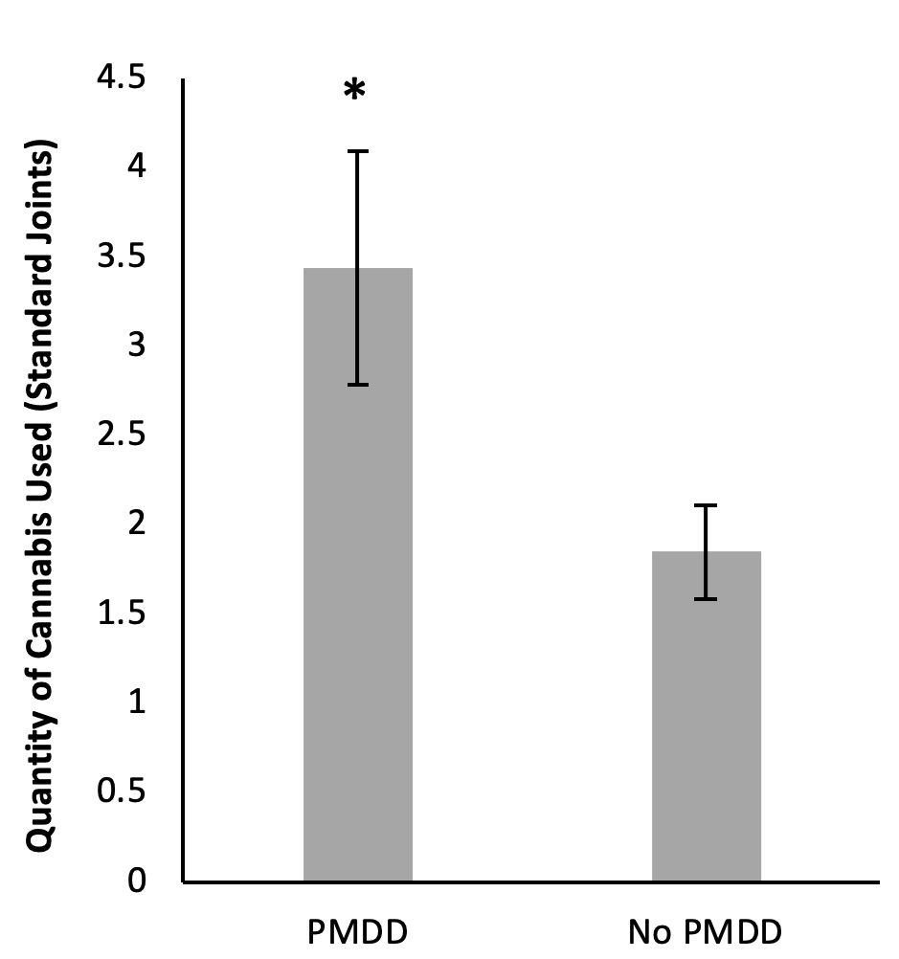
The Impact of Depressed Mood and Coping Motives in those with Pre-Menstrual Dysphoric Disorder on Cannabis Use Quantity Across the Menstrual Cycle
Kayla Joyce MSc, Kara Thompson PhD, Philip Tibbo MD, Kimberley Good PhD, M. O’Leary MSc, Tara Perrot PhD, Amanda Hudson PhD, Sherry Stewart PhD
Dalhousie University, Nova Scotia, Canada
Introduction
- Use of addictive substances change across the menstrual cycle ¹
- Cannabis use findings are mixed ^{2,3}
- Cannabis use may fluctuate across menstrual cycle phase, with increased use pre-menstrually and menstrually – phases characterized by increased negative affect ^{4,5,6}
- Pre-Menstrual Dysphoric Disorder (PMDD): a mood disorder diagnosis characterized by severe increases in depressed mood pre-menstrually and menstrually
- Substance use is generally higher in those with vs. without PMDD ⁷
PMDD Hypothesis
Increases in depressed mood and coping motives will be associated with increased cannabis quantity pre-menstrually and menstrually, particularly among females with PMDD vs. without
Methods
Participants. 69 naturally-cycling female cannabis users (M_{age} = 29.25, SD = 5.66, Range = 19-43 years)
Procedure.
Materials.
Daily Diary Survey. (1) Depressed Mood ⁸, (2) Menstrual Cycle Day, (3) Cannabis Coping Motives ¹⁰, (4) Cannabis Use Quantity ¹¹
Data Analysis. Standardization to a 28-day cycle ¹² and use of time-varying effect models
Results
With PMDD
- Depressed mood was associated with increased cannabis use menstrually (days 1-2)
Results (Continued)
- Coping motives were associated with increased cannabis use menstrually (days 1-3) and pre-menstrually (days 25-28)
- Females with PMDD reported higher quantities of cannabis use than females without (t₆₇=2.761, p<0.05)
Discussion
- Finding highlight the importance of female reproductive hormones on addictive behaviors and underline the need to incorporate clinical population differences, such as PMDD, in our conceptualization of these relationships
- Clinical implications for reproductive-aged females with PMDD who misuse cannabis (e.g., adaptive skills to manage depressed mood and coping motives pre-menstrually and menstrually)
References Available Upon Request
Results
1
Telephone Screening
Surveys & Saliva Sample
3
32 Days of Surveys (via Smartphone)
4
2
Saliva Sample
5
Debriefing & Compensation
*
Menstrual
Days 1 to 5
Premenstrual
5 days prior to menstruation
Follicular
Days 6 to 12
Luteal
Days 17 to premenstrual phase
Ovulatory
Days 13 to 16
References available upon request

