Slide 1
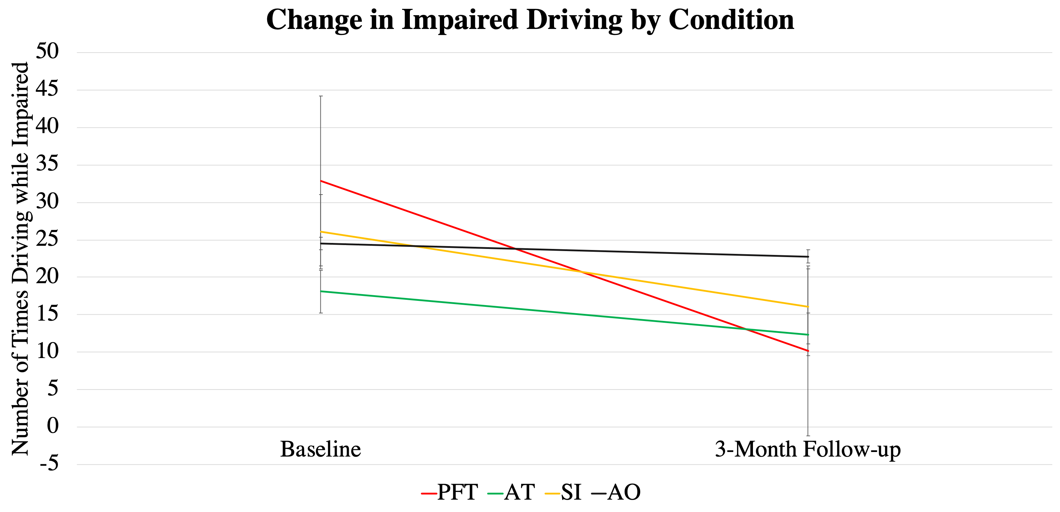
An Interactive Personalized Feedback and Text-Messaging Intervention
is Associated with Reductions in Substance-Impaired Driving
Shelby A. King, Sterling M. Hubbard, & Jenni B. Teeters
Western Kentucky University
Introduction
Methods
Data Analyses and Results
Substance-impaired driving continues to be a national public health concern; the use of cannabis and alcohol is associated with greater psychomotor impairment, consequently worsening an individual’s driving ability.
Due to the permissive attitudes regarding impaired driving among individuals ages 18-24, young adults are at an elevated risk for substance-impaired driving, with data suggesting that up to one-third of college students report driving after drinking and/or cannabis use in the past year.
To date, little research has investigated whether brief, technology-based interventions can be used to reduce substance-impaired driving among young adults.
Recent research indicates that interventions that incorporate personal contact lead to larger effect sizes than fully automated interventions.
The present study compared an interactive text-messaging intervention to an automated text-messaging intervention in the context of a brief, mobile-phone-based substance-impaired driving intervention.
Participants
N = 46 young adult alcohol and cannabis users
68.1 % Female
73.5 % Caucasian
Average age: 21.57
Procedures
Eligibility requirements included:
18 years or older
Access to a motor vehicle
Report driving after drinking two or more drinks and/or driving after cannabis use at least three times in the past three months
Participants completed measures that assessed substance impaired driving at baseline and 3-month follow-up
Participants were randomly assigned to one of 4 conditions:
PFT: personalized feedback document plus interactive text-messaging (n = 12)
AT: personalized feedback plus automated text messaging (n = 11)
SI: active control condition – substance use information (n = 12)
AO: assessment only control condition ( n = 11)
Repeated measures ANOVAs were run to compare the number of times driving while impaired over time across conditions.
PFT condition led to significantly greater reductions over time in the number of times driving while impaired compared to AO condition (p = .022).
PFT condition led to greater reductions over time in the number of times driving while impaired than AT condition, though this difference was not significantly significant (p = .066).
Text-messaging conditions (PFT & AT) did not result in significantly greater reductions in substance-impaired driving compared to SI condition (p = .227).
Baseline Assessment
Graph 1. Mean number of reported impaired driving times at baseline and 3-month follow-up by condition
Aims
Conclusions
Contact Information
The primary aim of the present study is to assess the efficacy of a brief mobile-based intervention with personalized feedback and interactive text-messaging in reducing cannabis and alcohol-impaired driving among young adults.
A secondary aim is to determine whether interactive text-messaging is more efficacious than automated text-messaging.
PFT
AT
SI
AO
These findings provide preliminary support for the short-term efficacy of a mobile-delivered personalized feedback intervention with interactive text-messaging in reducing substance-impaired driving among young adults.
Due to Covid-19, 3-month follow-up data could not be collected from half of the originally enrolled sample, resulting in underpowered analyses.
Additional data will be collected in the coming year.
Shelby King, B.S.
Shelby.king819@topper.wku.edu
Sterling Hubbard, B.S.
Sterling.hubbard816@topper.wku.edu
Jenni Teeters, Ph.D.
Jenni.teeters@wku.edu
3 Month Follow – up
Assessment
3 Month Follow – up
Assessment
3 Month Follow – up
Assessment
3 Month Follow – up
Assessment

