Slide 1
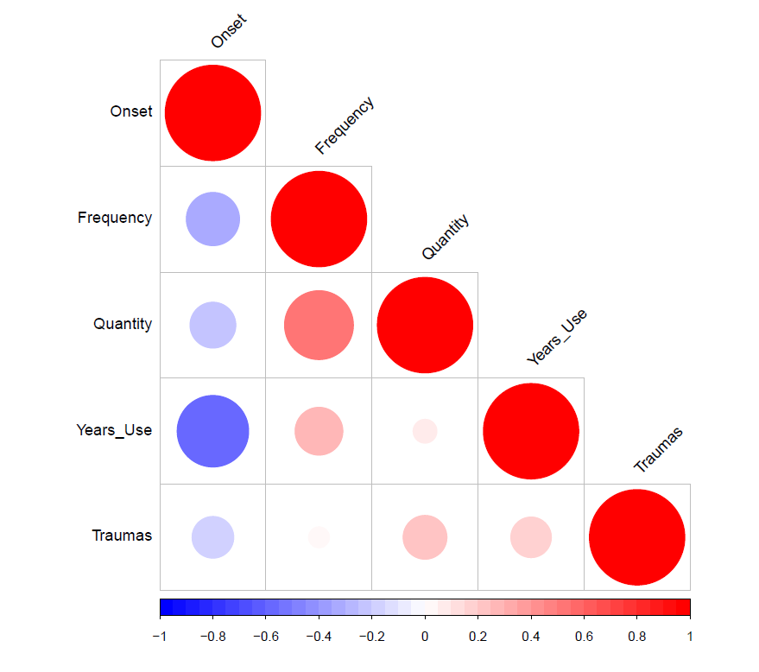
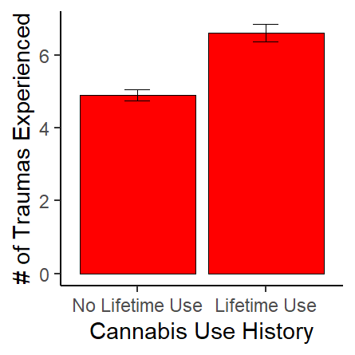
Examining Associations Between Trauma Exposure and Cannabis Use Frequency, Quantity, Duration, and Age of Onset
Kelsey C. Woodward, Annalee S. Ellis, Jenni B. Teeters, Matthew J. Woodward
Western Kentucky University
INTRODUCTION
Prior research has identified an association between history of trauma exposure with greater likelihood of lifetime cannabis use
Little research has expanded upon this association, making it unclear whether trauma exposure is associated with cannabis use beyond lifetime use
Trauma exposure is a risk factor for a number of deleterious outcomes; therefore, it is important to further examine the influence of trauma exposure on cannabis use
The current study examined associations between trauma exposure and various indices of cannabis use
PROCEDURE
Participants completed the following measures:
Trauma exposure: Life Events Checklist for DSM-5 (LEC-5)
Cannabis use: Daily Sessions, Frequency, Age of Onset, and Quantity of Cannabis Use Inventory (DFAQ-CUI)
PTSD symptoms: PTSD Checklist for DSM-5 (PCL-5)
Logistic regression and correlational analyses were conducted to examine the associations between trauma exposure and various indices of cannabis use.
Follow-up analyses controlled for the influence of posttraumatic stress disorder (PTSD) in these associations
Figure 2. Associations Between Trauma Exposure and Cannabis Use Indices
PARTICIPANTS
722 female undergraduates 18 years or older (M=19.0)
Participants completed an online survey through a psychology subject pool as part of screening for a larger study
RESULTS
Thirty-seven percent (n = 266) indicated a lifetime history of cannabis use
Greater trauma exposure was significantly associated with a greater likelihood of a lifetime history of cannabis use (OR = 1.14, p < .001)
Greater trauma exposure was significantly associated with:
younger age of onset of cannabis use r(262) = -.16, p < .01
greater duration of cannabis use r(236)=.14, p = .03
greater quantity (measured in grams) of cannabis use r(175)=.20, p < .01
Frequency of cannabis use was not significantly associated with trauma exposure, r(266) = -.01, p = .82
Associations remained significant after controlling for PTSD symptoms
Figure 1. Comparison of Trauma Exposure by Lifetime Cannabis Use History
CONCLUSIONS
Trauma exposure is associated with a range of indices of cannabis use beyond lifetime history of use, even after accounting for PTSD symptoms
These findings highlight the importance of extending examination beyond cannabis use frequency to multiple indices of use
Although trauma exposure may serve as a risk factor for elevated cannabis use, it is also possible that cannabis use may increase the risk of trauma exposure
Future longitudinal studies must be conducted to determine the direction of the relation between trauma exposure and cannabis use, as well as mechanisms linking these behaviors

