Slide 1
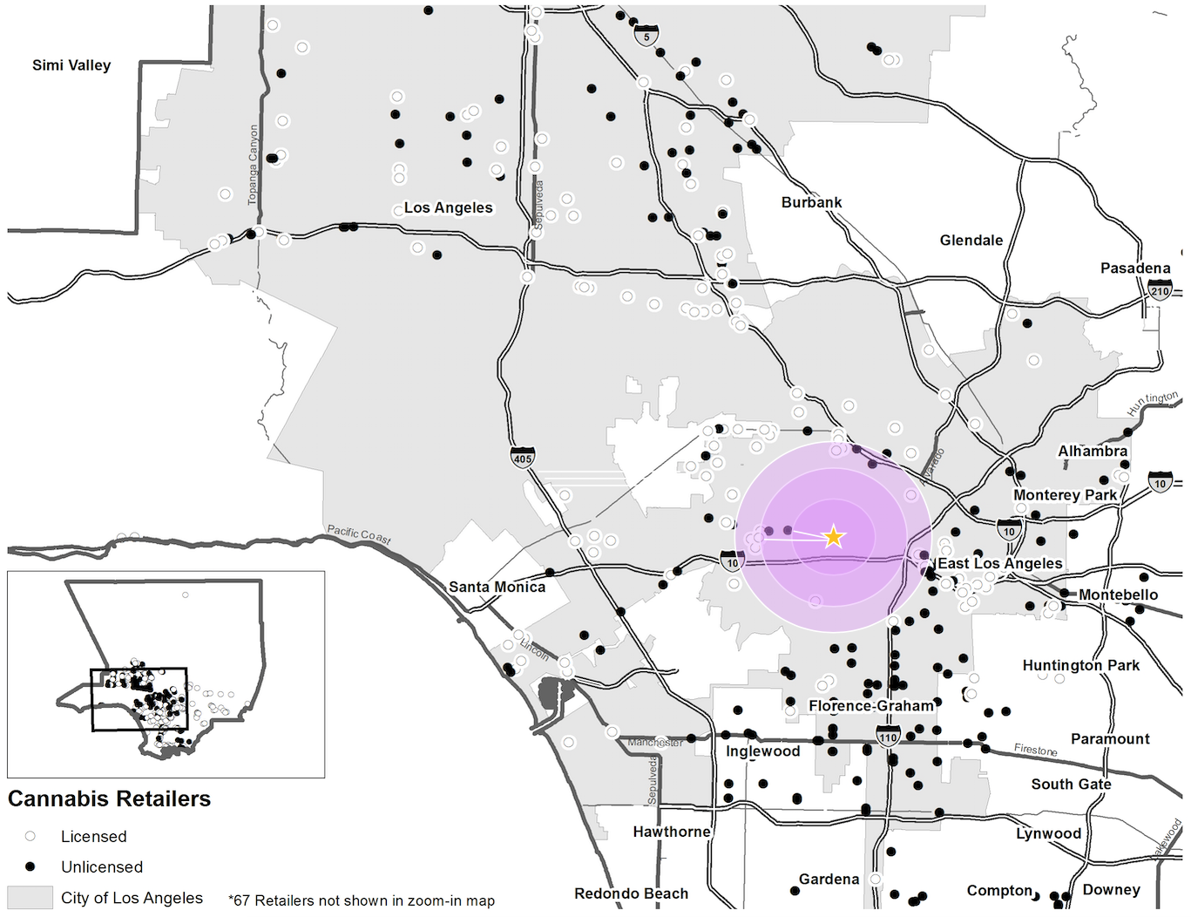
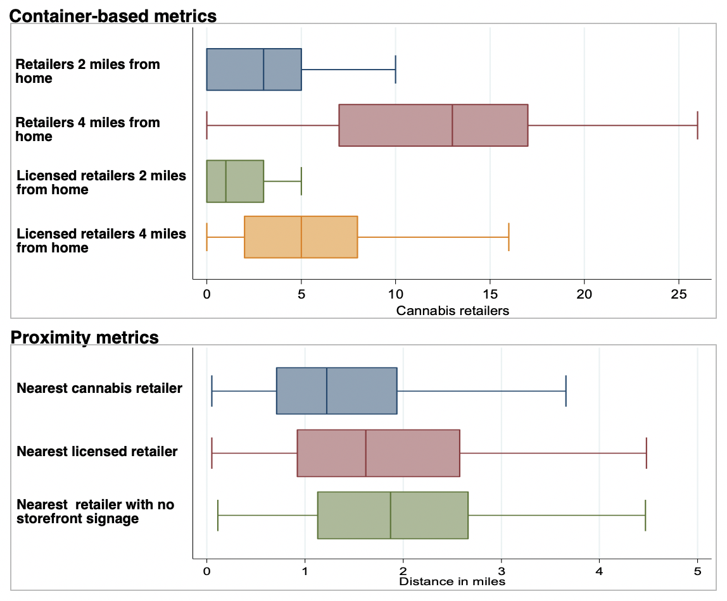
The cannabis retail environment for young adults in Los Angeles: which metrics matter
Caislin Firth, PhD ^{1,2}, Rachana Seelam, MPH ², Anthony Rodriguez, PhD ³, Regina Shih, PhD⁴, Joan Tucker, PhD ² , Elizabeth D’Amico, PhD ² , Eric Pedersen, PhD ^{2,5} ¹ Faculty of Health Sciences, Simon Fraser University, Burnaby, British Columbia, Canada ² RAND Corporation, Santa Monica, California; ³ RAND Corporation, Boston, Massachusetts; ⁴ RAND Corporation, Arlington, Virginia ⁵Department of Psychiatry and Behavioral Sciences, University of Southern California, Los Angeles, California
Sample of cannabis retailer metrics
Background
Researchers and policy makers need clear measures of cannabis retailer density to support policies that mitigate unintended harms of cannabis legalization.
We developed cannabis retailer density metrics and assessed whether they were associated with young adult cannabis use in Los Angeles County, California.
< 2 miles
< 4 miles
< 2 miles &
licensed
< 4 miles &
licensed
.
Methods
Closest retailer
Study population Young adults (21-25 years old) living in Los Angeles (n 1097); completed health survey Jan 2018-May 2019*
Cannabis retailer addresses from webscraping cannabis registries (Weedmaps, Leafly) and conducting field visits
Cannabis retailer density metrics: 1) Proximity 2) counts within 5- 10- 15- minute driving distances** for licensed and unlicensed retailers were calculated for each participant
Fit multi-level logistic regression models to assess which metrics were associated with any cannabis use in the past 30 days. Models adjusted for: age, gender, race/ethnicity, college student, census tract median income (census tract-level random intercept)
Closest licensed retailer
Closest retailers with no signage
Discussion
Findings indicate cannabis retailer density metrics may be important indicators for cannabis use among young adults
Future analysis: Assess relationship with frequency of cannabis use, high potency cannabis product use (e.g. concentrates, vaping)
Replicate study in other metropolitan areas with legal cannabis markets
Cannabis retailers in Los Angeles County, 2019
Results
30% used cannabis in the past month
Cannabis use significantly associated with licensed retailers within 4 miles
(OR:1.03, 95% CI:1.00–1.07)
Other metrics were not significantly associated with past month cannabis use
*Participants were from existing cohort initially recruited in 2008 from 16 middle schools in Southern California. Our analysis uses 11th wave of survey data
**Corresponds to 2- 4- 7- mile buffers
caislin_leah_firth@sfu.ca
Work supported by National Institute on Drug Abuse grant awarded to Eric Pedersen (R21DA047501) and a National Institute on Alcohol Abuse and Alcoholism grant awarded to Elizabeth D’Amico (R01AA025848).
caislinf

