Slide 1
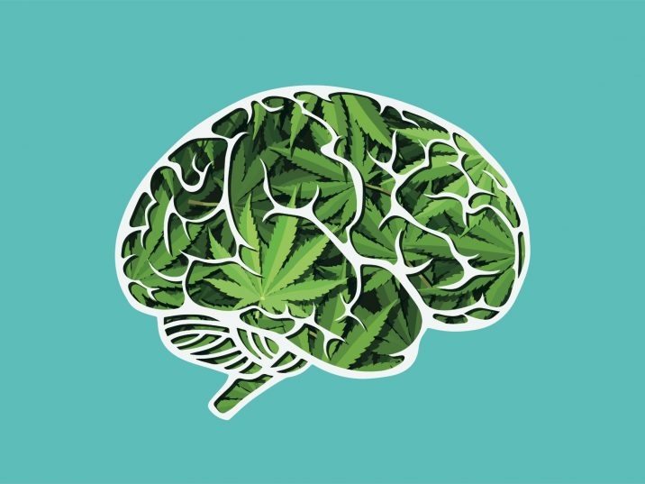
Do Cannabis Use Motives Mediate the Relationship Between PTSD Symptoms and Cannabis Craving to Trauma Cues?
Kyra N. Farrelly, Pablo Romero-Sanchiz, Ioan. T Mahu, Sean Barrett, Pam Collins, Daniel Rasic, Sherry H. Stewart
Introduction
Method
Results
Discussion
Background
Cannabis use rates high within trauma-exposed populations¹
Overall mixed evidence for the impact of cannabis use on PTSD²
Coping motives: common in trauma-exposed populations, related to problematic cannabis use, and poorer outcomes^{3,4}
Using cannabis to cope has potential to create a learned response of cannabis craving from pairing a trauma cue and drug-related stimuli
Learned craving response from pairing trauma cue and drug stimuli in alcohol and cocaine users with a trauma history^{5,6,7}
Cannabis craving should be examined as it can encourage and maintain use and is a symptom of CUD^{8,9,10}
Our lab previously found increased total and relief craving after trauma cue exposure compared to neutral and cannabis¹¹
The Current Study
Aim
Examine coping motives as a mediator for PTSD symptoms and cannabis craving to a personal trauma cue exposure
Hypotheses
Hypothesis 1: PTSD symptoms will predict cannabis craving after exposure to a personalized trauma cue
Hypothesis 2: Cannabis coping motives will mediate the relationship of PTSD symptoms and craving
Individuals with greater PTSD symptoms will report higher craving to a trauma cue due to a greater tendency of cannabis use to cope
Enhancement motives included as a comparator to examine if interaction is coping specific
Participants
Cannabis users who have experienced a traumatic event
N = 51 (54.9% male, 72.5% Caucasian)
M_{age} = 34.61 (SD= 13.01)
Procedure
“The friend reaches out and grabs the man they are picking on. The other man stabs a knife into his back once. He has no remorse on his face.”
Measures
PTSD Checklist for DSM-5 (PCL-5): 20 questions assessing PTSD symptoms¹²
Marijuana Motives Measure (MMM): 25 questions examining the 5 cannabis use motives¹³
The Scene Construction Questionnaire: Guide followed in session 1 to obtain information about the three personal cues¹⁴
Marijuana Craving Questionnaire – Short Form (MCQ-SF): 12-item self-report to examine cannabis craving after each cue¹⁵
Data Analysis
Hypothesis 1: Linear regression
Hypothesis 2: Boot-strapped confidence intervals (CIs)
Descriptive statistics
Means and standard deviations of the three model variables.
The mean PCL-5 score is just above clinical cutoff for a PTSD diagnosis¹²
Craving scores higher than ratings for a population beginning a quit attempt¹⁶
Hypothesis tests
Hypothesis 1:
*Significant path
The total effect (c) of PTSD symptoms to cannabis craving to a trauma cue was significant
Therefore our first hypothesis was supported
Hypothesis 2:
*Significant path
Both indirect effects not significant
The a1 and a2 pathways not significant
Therefore, our second hypothesis was not supported
However, PTSD symptoms and coping motives each had an independent effect on craving after a trauma cue
PTSD symptoms and coping motives explained 42% of the variance in cannabis craving after the trauma cue
↑ PTSD symptoms predicted ↑ cannabis craving after trauma cue exposure
Consistent with our lab’s previous finding¹¹
In-line with previous literature that found PTSD symptom severity is associated with cannabis craving¹⁶
Additional finding that coping motives had a unique effect on cannabis craving elicited by the trauma cue
Further implicates the role of coping motives in negative consequences of cannabis use
Lack of enhancement effects suggest relationship is coping specific
However, our second hypothesis was not supported
Coping motives did not mediate PTSD symptoms and craving to a trauma cue
Consistent with other research that did not find a direct relationship between PTSD and coping motives^{17,18}
However, contrasts with literature that found associations between PTSD symptom severity and reported coping motives^{3,16}
The lack of support for our second hypothesis could be due to potential moderators between PTSD symptoms and coping motives that were not examined
E.g., sleep-related variables have been found to interact with PTSD symptoms to predict coping motives^{17,18}
Implications
Findings help provide insight into factors that can trigger a drug craving to trauma cues
Helps with prevention/treatment by demonstrating individuals to target to prevent conditioned craving from a trauma memory
Implications for prescribing medicinal cannabis
Variable | M | SD
PCL-5 | 346.04 | 16.61
MMM_Coping | 14.98 | 5.51
MCQ_1 | 497.57 | 18.18
Telephone Screening
Inform study criteria, eligibility, PTSD score
Session 1
Interview for trauma story
Take Home Questionnaires
Create personal audio & visual cue
Session 2
Exposure to personal cues
PTSD Symptoms
Cannabis Craving
c path: 0.43 (0.15), [0.14, 0.73]*
Coping Motives
b1 path: 7.82 (2.44), [2.92, 12.72]*
a1 path: 0.01 (0.1), [-0.01, 0.03]
Indirect effect: 0.05 (0.08), [-0.07, 0.23]
PTSD Symptoms
Cannabis Craving
c’ path: 0.46 (0.14), [0.19, 0.73]*
a2 path: -0.01 (0.1), [-0.03, 0.01]
Enhancement Motives
b2 path: 1.15 (2.53), [-3.94, 6.25]
Indirect effect: -0.01 (0.03), [-0.10, 0.03]
Acknowledgements
Kyra Farrelly, B.A., email: kyrafarrelly7@gmail.com
Notes:
Cannabis use is a common phenomenon among individuals who have been exposed to a trauma. This is significant as trauma history is associated with heavy and daily cannabis use which can begin to lead into issues like a cannabis use disorder. An important construct that can help understand cannabis use are motives. Specifically coping motives. Coping motives are classified as using in order to reduce negative affect. They are associated with higher rates of cannabis use, and poorer outcomes. Using cannabis to cope also has the potential to create a learned response of cannabis craving by pairing the trauma cue with the cannabis stimuli. This conditioned craving relationship has been found in other substances (e.g., alcohol and cocaine) through the use of cue-reactivity paradigms in trauma-exposed samples. However, no study has examined cannabis craving in those with a trauma history, or explored substance use motives as potential mediators.
So, the goal of the current study is to examine coping motives as a mediator between PTSD symptoms and cannabis craving to a trauma cue. The first hypothesis proposed was that PTSD symptoms will predict cannabis craving to a personal trauma cue exposure. The second hypothesis was that cannabis coping motives will then mediate the hypothesized relationship of PTSD symptoms and cannabis craving to a trauma cue.
Participants were cannabis users who also had a trauma history (predominantly Caucasian male, with a mean age of about 35). The study had four components – first there was a telephone screening to assess for eligibility. Next participants came in for their first in-lab session. This involved a face-to-face interview to obtain information on their trauma experience, a recent time they used cannabis, and a neutral situation. In-between sessions 1 and 2 participants were sent additional questionnaires through email surrounding personality, substance use, and cannabis use motives. During this time the interview from session 1 was used to create a personal 1 minute script for an audio recording and to help select an accompanying image for participants to view. During session 2 participants were exposed to this personal audio recording and image for each story. Following each cue they completed physiological and subjective (e.g., craving) measures.
For the current study measures, the PTSD checklist, MMM, scene construction questionnaire (to help with creating cues), and the marijuana craving questionnaire were used.
For results, the total effect pathway of PTSD symptoms to cannabis craving to a trauma cue was significant – meaning our 1st hypothesis was supported. The indirect effect with coping motives was not significant – meaning our second hypothesis was not supported. The missing effect here was the pathway of PTSD symptoms to coping motives. We did find however significant independent effects of both PTSD and coping motives to cannabis craving elicited by the trauma cue. These two variables explained 42% of the variance for cannabis craving to a trauma cue.
These findings help extend the cue-reactivity trauma and craving literature to cannabis users. The support for our first hypothesis is in line with previous research that has found PTSD symptoms and cannabis craving are related. We help build on this relationship by showing it holds for trauma cue elicited craving in lab. The additional finding of the independent effect of coping motives helps further demonstrate the role of coping motives in adverse cannabis outcomes (e.g., conditioned craving to a trauma cue).
The lack of support for our second hypothesis contrasts with some previous research, but is consistent with other studies that also found a lack of relationship between PTSD and cannabis as well as alcohol coping motives. These studies that did not find a relationship did find that sleep-related factors interacted with PTSD to predict coping motives. Therefore our study potentially suggests there are additional factors/moderators between this relationship that we did not examine.
Our study results have important implications as they not only implicate the independent role of PTSD and coping for conditioned cannabis craving but they help demonstrate individuals to target (e.g., those with more severe PTSD symptoms and greater coping motives) to prevent this conditioned cannabis craving to a trauma memory.

