Slide 1
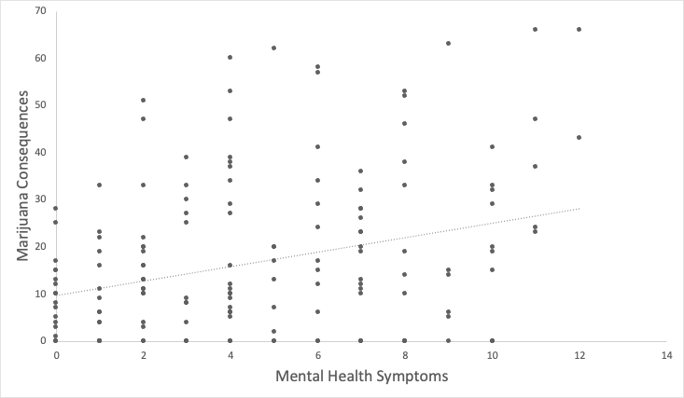
AN EXAMINATION OF RELATIONSHIPS BETWEEN MENTAL HEALTH SYMPTOMS, MARIJUANA USE OUTCOMES, AND MARIJUANA USE MOTIVES AMONG LATE ADOLESCENTS IN WASHINGTON STATE Elliot C. Wallace, Li-Hui Chu, & Jason J. Ramirez University of Washington, Center for the Study of Health and Risk Behaviors, Department of Psychiatry and Behavioral Sciences, Seattle, WA
INTRODUCTION
RESULTS
Adolescence is a critical period of development which can be affected by the initiation and escalation of marijuana use.
Examining risk factors of marijuana for adolescents is a public health priority.
Previous research on the relationship between marijuana use, depression, and anxiety among young adults is mixed.
Crane et al. (2015) found male, but not female, marijuana use was related to symptoms of depression. Johnson et al. (2009) observed a correlation between anxious arousal symptoms and frequency of marijuana use, but this relationship was not observed for depressive symptoms.
Despite this research, little is known regarding the relationship between reported mental health symptoms (i.e., depression and anxiety symptoms) and marijuana use among late adolescents.
The aims of the current analysis were:
To examine associations between mental health symptoms and marijuana use behavior among late adolescents.
To examine coping motives as a moderator of the relationship between mental health symptoms and marijuana outcomes.
Aim 1:
A series of initial linear regression models controlling for age and sex found mental health symptoms were not significantly associated with typical marijuana use (p > .05) but were significantly positively associated with marijuana-related consequences (β = 0.33, p < .001, Figure 1).
Aim 2:
Additional models which also included coping motives found a stronger endorsement of using marijuana to cope with negative affect was associated with more hours high in a typical week (β = 0.25, p < .05, Table 1) and more marijuana-related consequences (β = 0.24, p < .05, Table 2).
There were no significant interactions between coping motives and mental health symptoms in either model (ps > .05).
 | Typical Marijuana Use
 | B | SE B | t
 | Model 1
Biological Sex (male 0, female 1) | -3.80 | 2.17 | 1.75
Age | -0.55 | 1.15 | 0.47
Mental Health Symptoms | 0.55 | 0.33 | 1.63
 | Model 2
Biological Sex (male 0, female 1) | -3.97 | 2.37 | 1.67
Age | -1.26 | 1.33 | 0.94
Mental Health Symptoms | 0.04 | 0.43 | 0.10
Coping Motives | 0.96 | 0.38 | 2.54*
Mental Health x Coping Motives | -0.01 | 0.10 | 0.01
Table 1: Linear regression models predicting hours high in a typical week. Note: * p<.05
 | Marijuana Consequences
 | B | SE B | t
 | Model 1
Biological Sex (male 0, female 1) | -4.02 | 2.53 | 1.59
Age | 0.27 | 1.35 | 0.20
Mental Health Symptoms | 1.67 | 0.39 | 4.30***
 | Model 2
Biological Sex (male 0, female 1) | -4.39 | 2.58 | 1.70
Age | -0.73 | 1.45 | 0.51
Mental Health Symptoms | 1.36 | 0.46 | 2.94**
Coping Motives | 1.05 | 0.41 | 2.55*
Mental Health x Coping Motives | 0.01 | 0.11 | 0.02
METHODS
Participants and Procedures
A community sample of late adolescents was recruited from the greater Seattle area predominantly using social media.
The analytic sample included 170 participants between the ages of 15 – 18 (M_{age} = 16.86, SD_{age} = 0.94) that were stratified by biological sex (50% Female) and marijuana use such that participants ranged from no lifetime marijuana use to heavy, regular use.
Data presented here come from the first of three online surveys participants will complete over the course of six months.
Measures
Mental Health Symptoms: Symptoms of depression and anxiety were evaluated with the Patient Health Questionnaire-4 (PHQ-4; Kroenke, Spitzer, Williams, & Löwe, 2009), which includes the first two items of the PHQ-9 to assess the degree of a depressed mood over the past two weeks, and the first two items of the GAD-7 to assess symptoms of anxiety over the past two weeks.
Typical Marijuana Use: Marijuana use over the past three months was assessed using the Marijuana Daily Questionnaire (MDQ; Lee, Kilmer, Neighbors, Atkins, Zheng, Walker, & Larimer, 2013) in which participants are asked to report how many hours they were high on each day of a typical week over the past three months.
Marijuana Consequences: Participants reported the frequency of 26 consequences over the past three months which resulted from their marijuana use using the Marijuana Consequences Questionnaire (MCQ; Lee, Kilmer, Logan, Walter, Garberson, Neighbors, 2012).
Coping Motives: Participants rated how often 24 different reasons for using marijuana influenced their own use using the Comprehensive Marijuana Motives Questionnaire (CMMQ; Lee, Neighbors, Hendershot, Grossbard, 2009). Three items were summed to assess coping motives related to mental health.
Figure 1: Scatterplot of mental health symptoms and marijuana-related consequences.
Table 2: Linear regression models predicting marijuana-related consequences.
Note: * p<.05, ** p<.01, ***p<.001
DISCUSSION
The findings suggest that adolescents who report more mental health symptoms do not necessarily use more marijuana than those who report fewer symptoms, but may be at greater risk for experiencing negative consequences as a result of their usage.
Additionally, the results suggest a stronger endorsement of using marijuana to cope with negative affect is related to greater marijuana use and risk for experiencing negative consequences.
No evidence of moderation was found suggesting the relationships between mental health symptoms and marijuana use outcomes do not vary as a function of coping motives.
Screening during adolescence for early signs of mental health symptoms to predict risk may be beneficial towards preventing negative outcomes and providing early interventions for marijuana misuse.
SELECTED REFERENCES
Crane, N., Langenecker, S., & Mermelstein, R. (2015). Gender differences in the associations among marijuana use, cigarette use, and symptoms of depression during adolescence and young adulthood. Addictive Behaviors, 49, 33.
Johnson, Kirsten, Bonn-Miller, Marcel O., Leyro, Teresa M., & Zvolensky, Michael J. (2009). Anxious arousal and anhedonic depression symptoms and the frequency of current marijuana use: Testing the mediating role of marijuana-use coping motives among active users. Journal of Studies on Alcohol and Drugs, 70(4), 543-550.
Kroenke, K., Spitzer, R. L., Williams, J. B., & Löwe, B. (2009). An ultra-brief screening scale for anxiety and depression: the PHQ–4. Psychosomatics, 50(6), 613-621.
Lee, C.M., Kilmer, J.R., Neighbors, C., Atkins, D.C., Zheng, C., Walker, D.D., & Larimer, M.E. (2013). Indicated prevention for college student marijuana use: A randomized controlled trial. Journal of Consulting and Clinical Psychology, 81, 702-709.
Lee, C.M., Kilmer, J.R., Logan, D., Walter, T., Garberson, L., Neighbors, C. (2012). Development, Reliability and Validity of a New Measure of Marijuana Consequences. Manuscript in preparation
Lee, C. M., Neighbors, C., Hendershot, C. S., & Grossbard, J. R. (2009). Development and preliminary validation of a comprehensive marijuana motives questionnaire. Journal of studies on alcohol and drugs, 70(2), 279-287.
Data collection and poster preparation were supported by R21DA045092 (PI: Ramirez) from the National Institute on Drug Abuse and by a grant from the Alcohol and Drug Abuse Institute (ADAI) at the University of Washington.
Please send correspondence to Elliot Wallace at elliotcw@uw.edu

