Slide 1
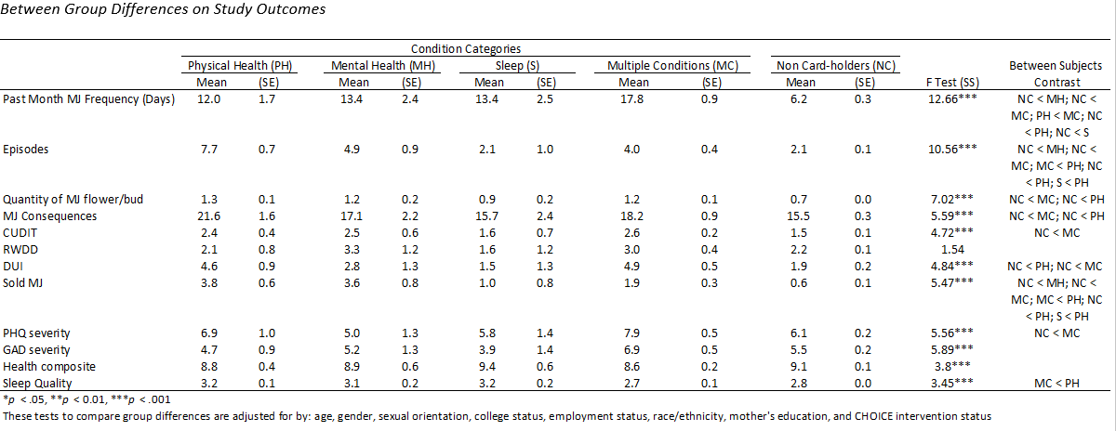
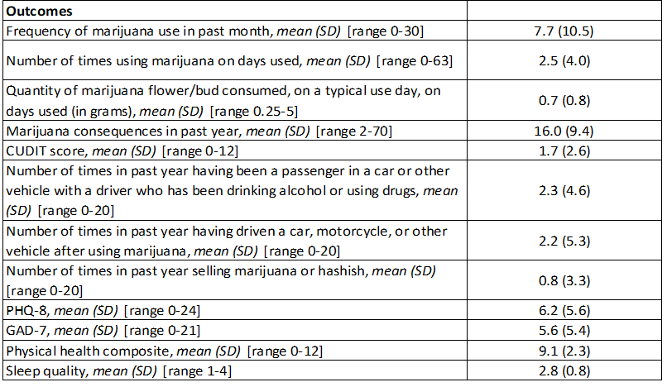
Why Young Adults Obtain A Medical Marijuana Card:
Associations With Health Symptoms, Risk, And Heaviness Of Use
Justin Hummer¹, Rachana Seelam, ¹ Eric R. Pedersen, ^{1,2}, Joan S. Tucker, ¹ & Elizabeth J. D’Amico¹
¹RAND Corporation, Santa Monica, CA
²University of Southern California, Department of Psychiatry and Behavioral Sciences, Los Angeles, CA
This research was supported grants R01AA016577, R01AA020883, and R01AA025848 from NIAAA awarded to Elizabeth J. D’Amico
BACKGROUND AND OBJECTIVE
Prior studies documenting more frequent and problematic use among young adults who have acquired medical marijuana (MM) cards have broadly compared those who use medically to those who use recreationally.
Gaining a better picture of how health symptoms and problematic use vary both within those who have a MM card for specific condition domains, and between those who do not have a MM card, can provide key information for medical practitioners and states interested in adopting or updating MM policies.
Young adults authorized to use MM were categorized into four mutually exclusive groups based on endorsements of qualifying conditions: (1) Physical Health only; (2) Mental Health only; (3) Sleep only; and (4) Multiple Conditions.
We examined differences across marijuana use, problems, mental and physical health, risk, and sleep for MM condition categories, and for those that only use marijuana recreationally.
Participants and Procedure
Data come from an online survey completed at wave 11 of a multiwave study, during 2018-2019 when participants were approximately 22 years old.
The analytic sample for this study was comprised of young adults residing primarily in Southern California who reported past year marijuana use (n = 1,197).
46% male (n = 547); 42% Hispanic (n = 503), 26.8% non-Hispanic White (n = 321), 2.6% non-Hispanic Black (n = 31), 16.0% non-Hispanic Asian (n = 191), and 12.6% reported being ‘other’ race or multi-racial (n = 151).
Medical Marijuana Card Status
15.2% (n = 182) reported having a MM card
MM card holders were asked to “select all that apply” from a list of all qualifying conditions to become a medical marijuana patient in California according to Proposition 215, with revised Senate Bill (SB) 420.
Note. SB 420 includes a provision for “any other chronic or persistent medical symptom that either substantially limits a person’s ability to conduct one or more of major life activities as defined in the Americans with Disabilities Act of 1990, or if not alleviated, may cause serious harm to the person’s safety, physical, or mental health. Thus, participants could write in a response.
Then categorized into mutually-exclusive groups based on endorsement of conditions:
Key Findings
MM card holders, particularly those with physical health or multiple health conditions, reported heavier, more frequent, and more problematic and risky marijuana use compared to those using recreationally.
Despite this pattern, those in different MM condition categories were generally not found to be more symptomatic in domains of functioning relevant to their respective conditions, compared to different category groups or to those using recreationally. That is, compared to all other groups:
The mental health-only group did not report more symptoms of depression or anxiety
The physical health condition group did not report worse physical health
The sleep condition group did not report worse overall sleep quality
Conclusions
Many individuals struggle with legitimate medical and psychological concerns that can benefit from MM .
If marijuana is to be used for medicinal purposes, it should be subjected to the same evidence-based review and regulatory policies as those used for other pharmaceutical agents prescribed by physicians.
Findings emphasize the importance of providers conducting a careful assessment of reasons for needing a card, along with use, to reduce potential harms while adding credibility to a medical movement with genuine promise of relief for many medical conditions.
Physical Health (n = 34)
AIDS, anorexia, arthritis, cachexia, cancer, chronic pain, glaucoma, migraine, persistent muscle spasms, seizures, severe nausea, back pain; fibromyalgia; period pains; sciatica
Mental Health (n = 18)
Anxiety, depression, eating disorder, panic attacks
Sleep (sleep problems) (n = 15)
Multiple Conditions (e.g., Mental Health and Physical Health) (n = 113)
No MM Card (n = 1,105; 84.8%)
Contact information:
Justin F. Hummer, Ph.D.
Associate Behavioral and Social Scientist
RAND Corporation
jhummer@rand.org

