Slide 1
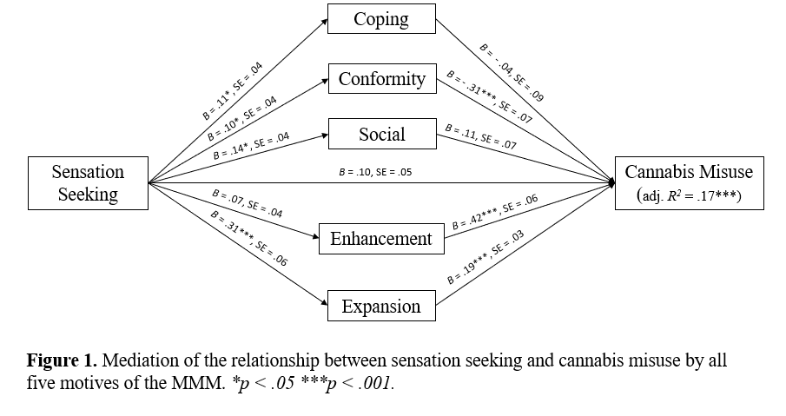
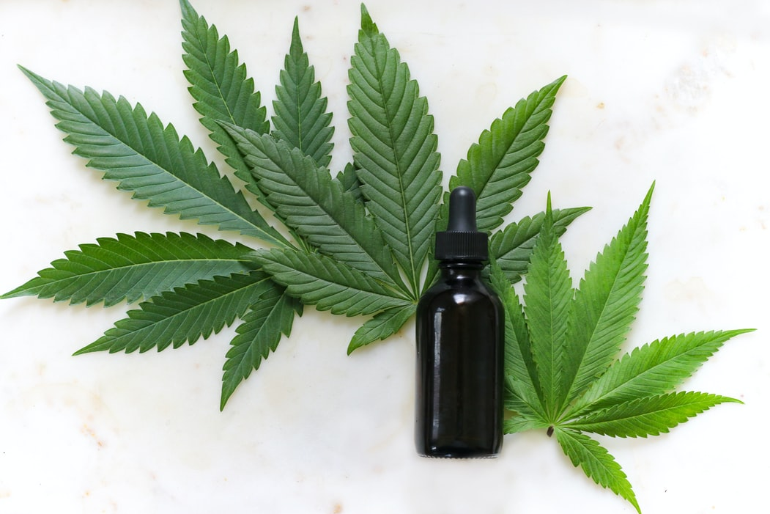
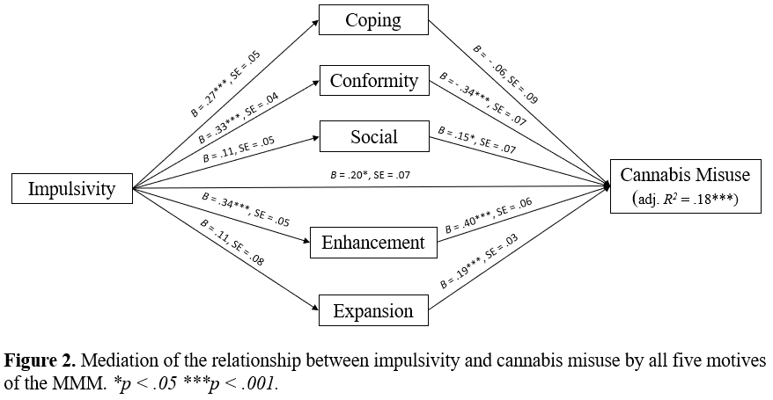
The role of motives in understanding the link between personality and cannabis misuse
Karen T. Y. Tang¹, Elijah Otis¹, Alexandra Loverock², T. Cameron Wild², Igor Yakovenko^{1,3}
¹Department of Psychology and Neuroscience, Dalhousie University, Canada; ²School of Public Health, University of Alberta, Canada;
³Department of Psychiatry, Dalhousie University, Canada
INTRODUCTION
PURPOSE
RESULTS
Personality risk factors represent phenotypes of vulnerability to substance misuse
An emerging model for studying personality-matched substance use interventions is based on the Substance Use Risk Profile Scale (SURPS)
With the loosening of restrictions on cannabis, research focusing on understanding cannabis use in young adults remain a vital area of research
The literature supports the mediating role of coping motives on personality risk factors and problematic cannabis use; however, the role of other types of motives has remained largely unexplored
We hypothesized that:
Sensation-seeking (SS) and impulsivity (IMP), but not anxiety sensitivity and hopelessness, will be associated with greater cannabis use problem severity
Motives for use (i.e., coping, conformity, social, enhancement, expansion) will mediate the association between personality risk and cannabis use problem severity
Examine the mediating role of cannabis use motives between personality and cannabis misuse among university students
As hypothesized, both SS (r = .072, p = .045) and IMP (r = .136, p < .001) predicted greater cannabis use problems
Mediation Analyses
Conformity motives were a significant mediator between SS and IMP and cannabis use, whereby higher levels of SS/IMP led to greater endorsement of conformity motives, which in turn led to lower cannabis misuse
Expansion motives were a significant mediator between SS and cannabis use
Enhancement motives were a significant mediator between IMP and cannabis use
FIGURES
METHODS
CONCLUSION
Sample
N = 1073 (42.2% female, M_{age} = 22.57, SD = 4.50, age range: 17-54)
Stratified random sample of students by type of degree
Procedure
Online Survey
IV: Personality risk factors: SS, IMP, anxiety sensitivity, hopelessness
DV: CUD severity
Mediator: Motivations for cannabis use
Design: Ordinary Least-Squares (OLS) parallel mediation analysis
Understanding reasons for use (i.e., motives) allows us to identify those at greatest risk for cannabis misuse
Findings from this study may help explain the underlying mechanisms by which personality risk factors lead to cannabis use disorder in young adults
Implications: Development of personality-specific interventions for cannabis use could be implemented when treating CUD, especially to prevent development of problems in high-risk individuals
Further Information: karen.tang@dal.ca

