Slide 1
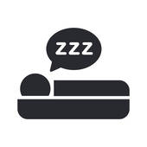
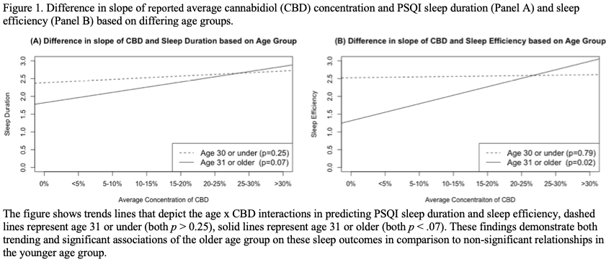
Cannabis Use and Sleep: Expectations, Outcomes, and the Role of Age
Background
Results
Cannabis is frequently associated with expectations of improved sleep, but frequent use of cannabis is associated with a large array of sleep deficits including sleep quality problems, sleep disturbances, longer sleep latency, lower sleep duration, and insomnia.
Components often neglected in modern studies of cannabis and sleep are assessment of alternative routes of administration (such as edibles), information on THC/CBD concentration, and the potential influence of age in this relationship.
These aspects are Important to study in the relationship of cannabis and sleep because: 1)Different routes of administration can affect the onset and duration of the effects of cannabis. 2)There is lab-based evidence of low dose CBD and and high dose THC disturbing sleep while high dose CBD and low dose THC aid sleep, but there are not many studies on chemical concentration in community samples. 3 )The endocannabinoid system may modulate sleep disorders and circadian rhythm uniquely as adults age. There are also age-related differences in pharmacokinetics and pharmacodynamics that influence the biobehavioral effects of substances such that biological changes associated with increases in age can not only increase the distribution rate and volume of lipophilic drugs like THC and CBD but also decrease the elimination of them, potentially increasing the side effects of cannabis
We hypothesized that increased cannabis frequency/behaviors would be associated with both expectations of cannabis as a sleep aid and increased sleep deficit outcomes. We were particularly interested in age as a moderator of the relationship among cannabis metrics and sleep; thus, we tested an age x cannabis interaction measure to evaluate this further.
Currently using cannabis, both days of cannabis flower and days any cannabis used in the past two weeks, and current frequency of smoking were associated with increased expectations that cannabis use improves sleep (all β > 0.03, p < 0.04).
Frequency of recent use and reported average THC or CBD concentration were largely not associated with sleep outcomes. However, endorsing current cannabis use was associated with worse subjective sleep quality (β = 0.33, p = 0.01) and increased frequency of consuming edibles was associated with higher global PSQI scores (worse overall sleep) (β = 0.20, p = 0.03).
Increased reported average CBD concentration, however, was significantly associated with better sleep efficiency (β = -0.11, p = 0.01) and sleep duration (β = -0.08, p = 0.03) and the interaction terms for both models were significant (both β < - 0.01, p < 0.02) suggesting a potential moderating influence of age on these relationships.
Evan A. Winiger ^{1,2,} Leah N. Hitchcock ³, Angela D. Bryan ^{2,3}, L. Cinnamon Bidwell ^{2, 3}
Affiliations:
1 Institute for Behavioral Genetics, University of Colorado, Boulder.
East Campus, 1480 30th Street, Boulder, CO 80309.
2 Department of Psychology and Neuroscience, University of Colorado, Boulder. Muenzinger Psychology Building, 1905 Colorado Ave, Boulder, CO 80309.
3 Institute of Cognitive Science, University of Colorado, Boulder. Center for Innovation and Creativity, 1777 E Exposition Drive, Boulder, CO 80301.
ABSTRACT
Objectives: Estimate the associations of cannabis use with expectations of cannabis being a sleep aid, subjective sleep outcomes, and the influence of age on these relationships.
Methods: In 152 moderate cannabis users (67% female, mean age = 31.45, SD = 12.96, age range = 21-70) we assessed the influence of cannabis use history and behaviors on expectations of cannabis being a sleep aid and subjective sleep outcomes via the Pittsburgh Sleep Quality Index (PSQI). We used moderation analysis to examine the role of age in the relationship between cannabis use and subjective sleep outcomes.
Results: Cannabis use along with more frequent cannabis use were associated with increased expectations that cannabis use improves sleep (all β > 0.03, p < 0.04). Frequency of recent cannabis use and reported average THC or CBD concentration were largely not associated with subjective sleep outcomes. However, endorsing current cannabis use was associated with worse subjective sleep quality (β = 0.33, p = 0.01) and increased frequency of consuming edibles was associated with higher global PSQI scores (worse overall sleep) (β = 0.20, p = 0.03). Furthermore, age was determined to have a moderating influence on the relationship between increased concentration of CBD and both better sleep duration and sleep quality (both p < 0.02).
Conclusion: Cannabis users have higher expectations of cannabis being a sleep aid, but few associations existed between cannabis use and subjective sleep outcomes with the exceptions of endorsing any cannabis use and frequency of edible use. Additionally, age may be an important moderator of the potential positive influence CBD concentration can have on sleep.
Methods
Sample
152 individuals (67% female, mean age = 31.45, SD = 12.96, age range = 21-70) who were recruited for a longitudinal study of cannabis use and anxiety symptoms
Primary Cannabis and Sleep Measures
Expected benefit of cannabis use improving sleep with responses including "Very improved”, “Somewhat improved”, “Not very improved”, “No improvement at all” (coded as 3-0)
Cannabis behavior measures including: Endorsing any current cannabis use, prior regular use, both frequency of edible use/consumption and of smoking flower cannabis
Cannabis history measures of the total number of days in the past two weeks that cannabis flower (Mean = 3.87, SD = 4.92), cannabis edibles (Mean = 0.89, SD = 2.01) and any cannabis use (Mean = 5.54, SD = 5.25) was reported (via TLFB)
Reported average THC and CBD concentration of cannabis typically used with responses including “0”, “Less than 5%”, “5-10%”, “10-15%”, “15-20%”, “20-25%”, “25-30%”, “Greater than 30%”
Past two-week sleep behavior via the Pittsburgh Sleep Quality Index (PSQI) measuring sleep efficiency, latency, quality, disturbances, medication, daytime dysfunction, and a global PSQI score.
Sleep-related Covariates
Gender, age, current alcohol use (AUDIT), and current depression/anxiety/stress (DASS)
Statistical Analysis
Linear regression models estimated both the main effects of cannabis on sleep expectations/subjective sleep outcomes and a potential moderating effect of age on the relationship between cannabis behaviors and subjective sleep outcomes via an interaction term between age and cannabis (with all appropriate variables mean centered)
Discussion
Results are consistent with research that has found that cannabis is often associated with expectations of improved sleep. This is important because expectations of cannabis as a sleep aid might lead to increased long-term cannabis use which could progress into negative effects on sleep as well as additional cannabis related issues
Prior studies support current cannabis use being associated with poor subject sleep quality. While prior studies have used oral administered CBD and THC (often in isolated or synthetic forms not typically used outside the laboratory) to look at sleep, this is the first observational study to look specifically at the associations of cannabis edibles and sleep.
Our analysis showing that higher reported average CBD concentration was associated with sleep improvements aligns with prior research which implies that high dose CBD has a sedating effect and is associated with sleep improvements.
The moderation effects found in the study could be explained by an increase in age being associated with differences in pharmacokinetics and pharmacodynamics that can influence biobehavioral effects of substances. While no prior study has collaborated this theory using biological methods, we would speculate that increases in age might lead to biological alterations that would influence metabolism, potentially increasing the volume/distribution of CBD in a user’s system and increasing the positive effects of CBD on sleep factors.
CONTACT
Evan Winiger (M.A.)
University of Colorado, Boulder CU Boulder East Campus, Boulder, CO 80309
evwi1996@Colorado.edu
(303) 492-7362

