Slide 1

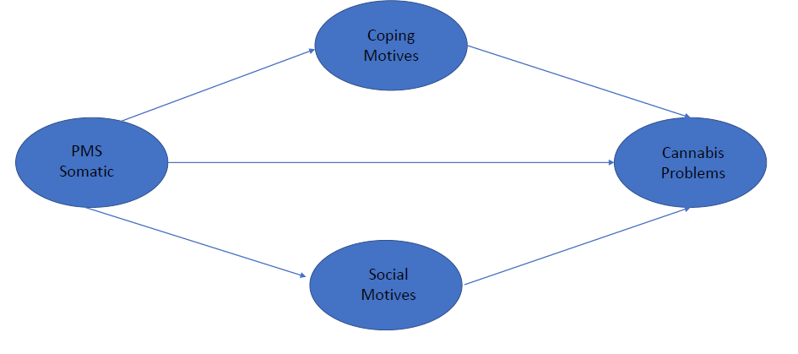
PMS Affective Symptoms Indirectly Linked to
Cannabis Use Frequency and Problems via Cannabis Coping Motives
Sherry H. Stewart, ¹ Kayla M. Joyce, ² Phillip Tibbo,¹ Nacera Hanzal, ³ & Kimberley Good¹
¹Dalhousie University, ²University of Manitoba, ³University of Ottawa
BACKGROUND
There appears to be a link between premenstrual syndrome (PMS) and substance use/misuse (see Joyce et al., 2020) Females with PMS engage in greater substance use (Strine et al., 2005) Females with PMS work harder to “buy” larger cannabis quantities (Mello & Mendelson, 1985) Remaining Gaps Mechanisms underlying the overlap of PMS with substance misuse remain poorly understood; motives (reasons for use) a promising candidate. Relatively little work in this area has focused on cannabis use/misuse, specifically
OBJECTIVE AND HYPOTHESES
Objective: Examine the relations of each PMS symptom component to each cannabis outcome (frequency and problems) as mediated through cannabis use motives Hypotheses: 1. Relations of PMS symptoms to both cannabis outcomes would be mediated through coping but not social cannabis use motives. 2. The indirect pathway through coping motives would be particularly strong in the case of PMS Affective symptoms as compared to other PMS symptoms
Results: indirect effects
.397**
.292*
.203 [.110]
.146
-.155
Results: principal components analysis
Figure 1. PMS Affective Symptoms Indirectly Linked to Cannabis Use Frequency via Cannabis CM (but not SM). Sobel test for indirect effect through CM = 2.01, p = .04; Sobel test for indirect effect through SM = -.96, n.s.
PAF-SF Item Content (A=affective; W=water retention; P=pain scale) | Factor 1 Affective | Factor 2 Somatic | Communality
2. Overwhelmed (A) | .861* | .000 | .742
3. Feel under stress (A) | .801* | .208 | .685
4. Irritable outbursts (A) | .783* | .234 | .668
5. Feel sad or blue (A) | .776* | .257 | .667
10. Feel bloated (W) | .201 | .854* | .770
9. Water retention (W) | .154 | .798* | .660
7. Weight gain (W) | .242 | .740* | .606
8. Abdominal pain (P) | .272 | .586* | .417
1. Painful breasts (P) | .005 | .387* | .150
6. Back/joint/muscle pain (P) | .398* | .393* | .313
 | 2.48 (.14) | 1.79 (.09) | p < .001
 | 15.80 (3.19) | 9.72 (2.23) | p = .625 | .013
METHODS
.397**
.341**
87 female cannabis users were community recruited for a daily diary study of cannabis use across the menstrual cycle (Joyce et al., 2020).
Measures for the present sub-study were completed at the first in-person meeting prior to the daily diary portion of the larger study
Measures:
Participants completed validated measures of PMS symptoms (PAF-SF), cannabis use motives (MMM), cannabis use frequency (30-day TLFB), and cannabis problems (CUDIT-R)
The PAF-SF is a 10-item measure of PMS symptoms, designed to tap 3 dimensions of PMS symptoms: affective, water retention, pain (Allen et al., 1991); its factor structure requires validation
The MMM (Simons et al., 1998) taps 5 distinct cannabis use motives; we focused on coping motives (CM) and compared with social motives (SM) as a less risky motive (Cooper et al., 2016) that should not mediate
.163 [.038]
.146
-.068
Figure 2. PMS Affective Symptoms Indirectly Linked to Cannabis Use Problems via Cannabis CM (but not SM). Sobel test for indirect effect through CM = 2.26, p = .02; Sobel test for indirect effect through SM = -.54, n.s.
.273*
.355**
.092 [.007]
CONCLUSIONS
PAF-SF contains 2 rather than 3 symptom dimensions (i.e., affective vs. somatic) Only PMS affective symptoms are indirectly related to adverse cannabis outcomes Mediation occurs through cannabis coping motives but not social motives for use Women with greater PMS affective symptoms use cannabis more frequently and problematically than other women via their greater use of cannabis to cope Coping motives as targets to treat or prevent PMS-cannabis problems comorbidity
.174
-.070
Figure 3. PMS Somatic Symptoms Neither Directly nor Indirectly Linked to Cannabis Use Problems. Sobel test for indirect effect through CM = 1.94, n.s.; Sobel test for indirect effect through SM = -.56, n.s. Results same for Cannabis Frequency outcome.

